Slide 1
小学英语一年级下册教材
模块重点单词和例句拓展汇总
海洋岛学校 英语组

Slide 2
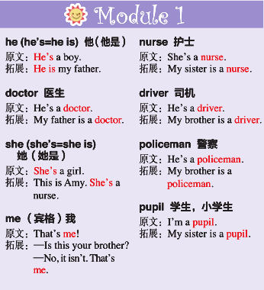
Module 1 Unit 1 He is a doctor.
Module 1 Unit 2 She is a nurse.

Slide 3
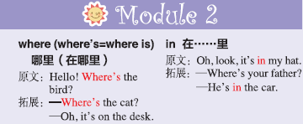
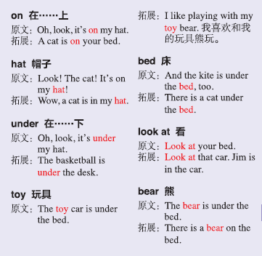
Module 2 Unit 1 Where’s the bird?
Module 2 Unit 2 The toy car is under the bed.

Slide 4
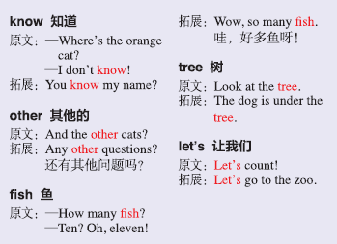
Module 3 Unit 1 Where’s the orange cat?
Module 3 Unit 2 How many green birds?

Slide 5
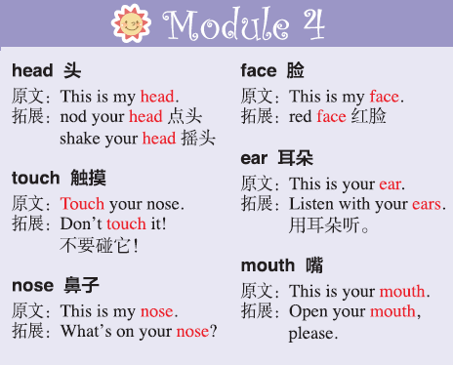
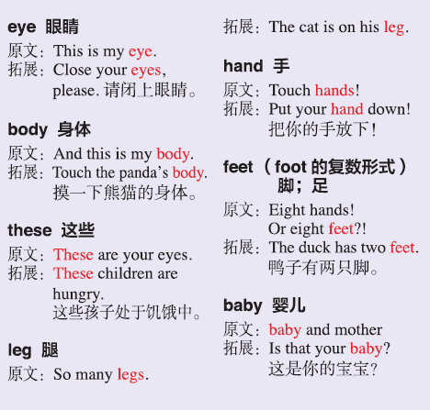
Module 4 Unit 1 This is my head.
Module 4 Unit 2 These are your eyes.

Slide 6
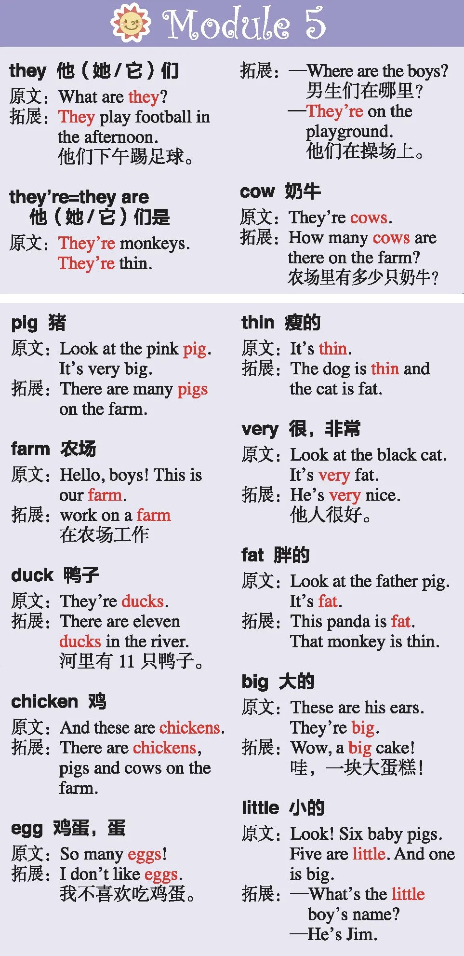
Module 5 Unit 1 They're cows.
Module 5 Unit 2 It's thin.

Slide 7
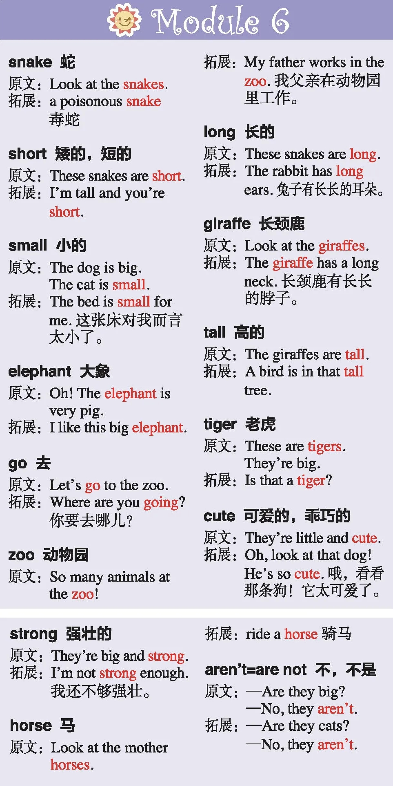
Module 6 Unit 1 These snakes are short.
Module 6 Unit 2 They're little and cute.

Slide 8
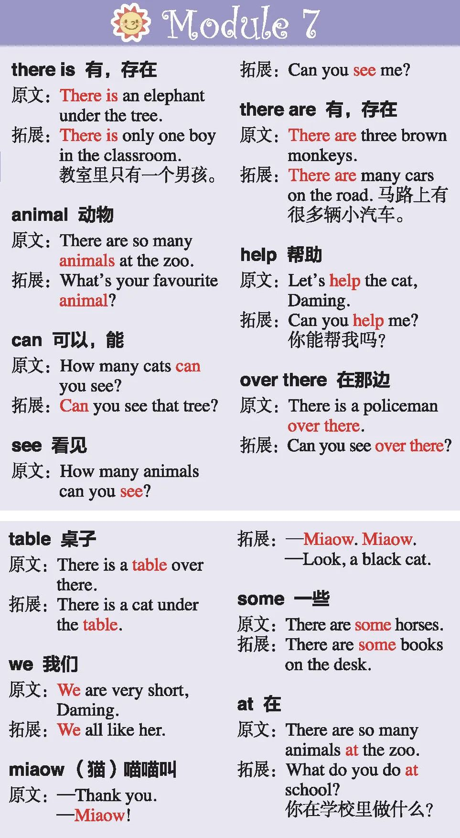
Module 7 Unit 1There is a cat in t
Module 7 Unit 2 She is a nurse.

Slide 9
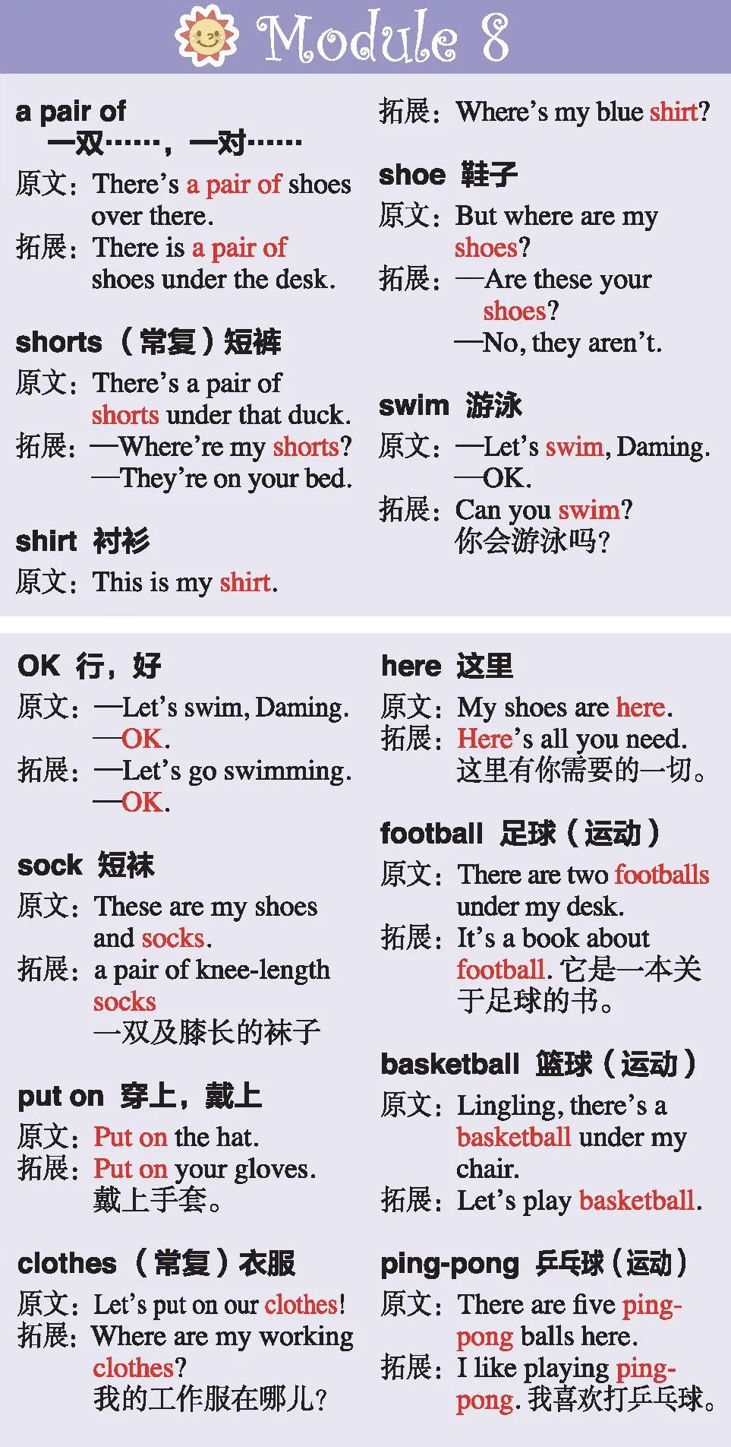
Module 8 Unit 1There's a pair of shorts under that duck.
Module 8 Unit 2 There are two footballs under my desk.

Slide 10
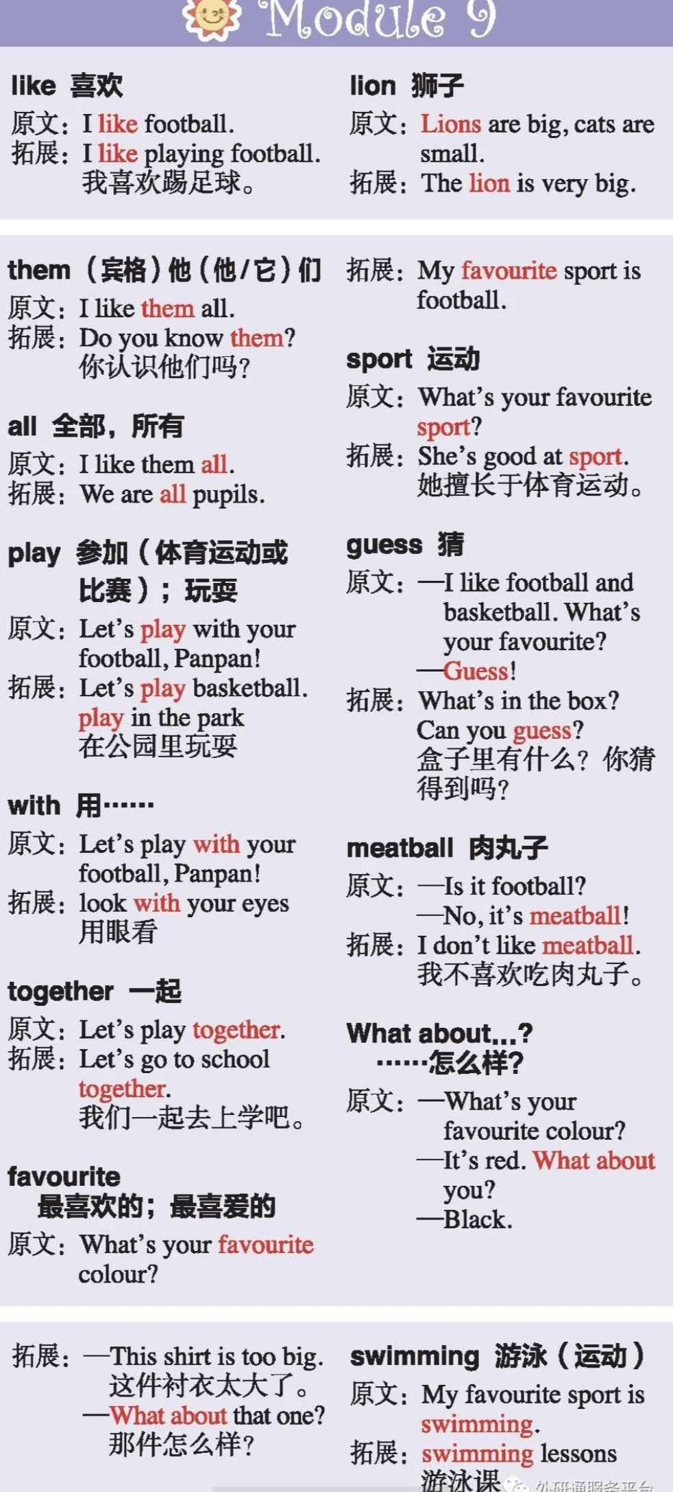
Module 9 Unit 1 I like football.
Module 9 Unit 2 What's your favourite sport?

