Slide 1
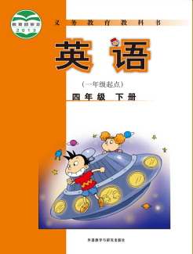
小学英语四年级下册教材
模块重点单词和例句拓展汇总
大长山岛镇中心小学 英语组

Slide 2
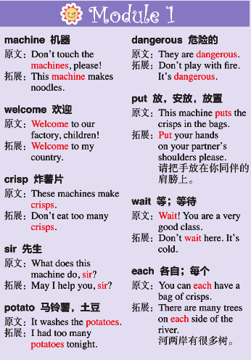
Module1 Unit1 Don't touch the machines, please!
Module1 Unit2 Don't feed the fish!

Slide 3
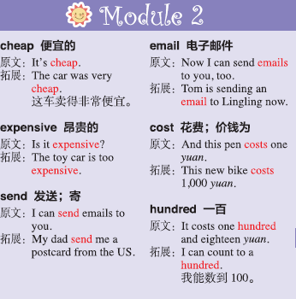
Module2 Unit1 It's cheap.
Module2 Unit2 It costs one hundred and eighteen yuan.

Slide 4
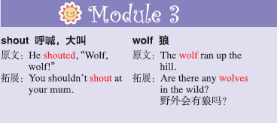
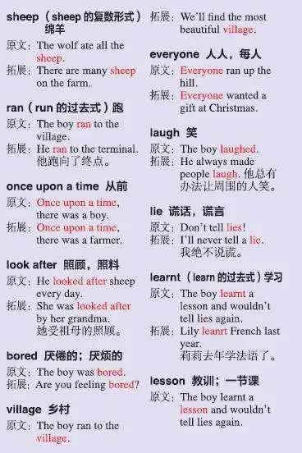
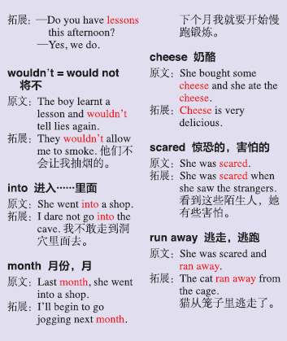
Module3 Unit1 He shouted, “Wolf, wolf!”
Module3 Unit2 She went into a shop.

Slide 5
Module4 Unit1 Dad played the erhu.
Module4 Unit2 I was very nervous.

Slide 6
Module5 Unit1 We're having a party.
Module5 Unit2 He's drawing books and birds.

Slide 7
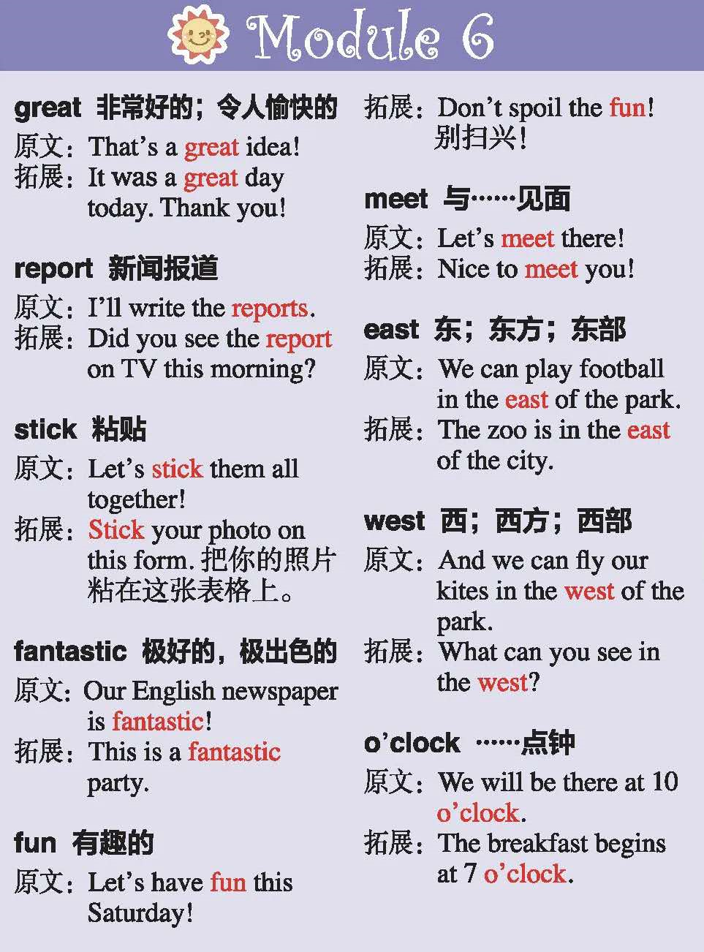
Module6 Unit1 I'll draw the pictures.
Module6 Unit2 Let's have fun this Saturday!

Slide 8
Module7 Unit1 What’s the time?
Module7 Unit2 It’s 6:30 am in New York.

Slide 9
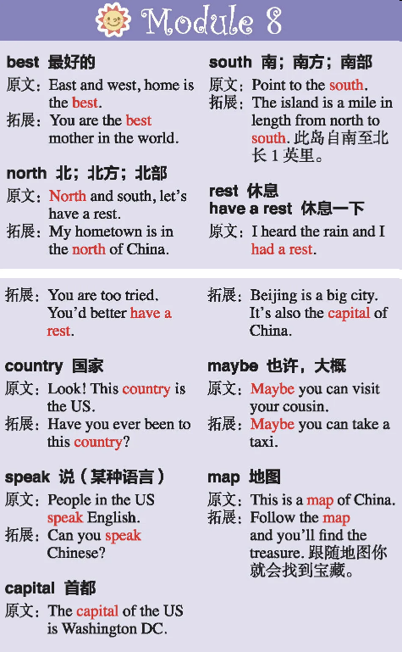
Module8 Unit1 He lives in the east of the US.
Module8 Unit2 It’s in the north of China.

Slide 10
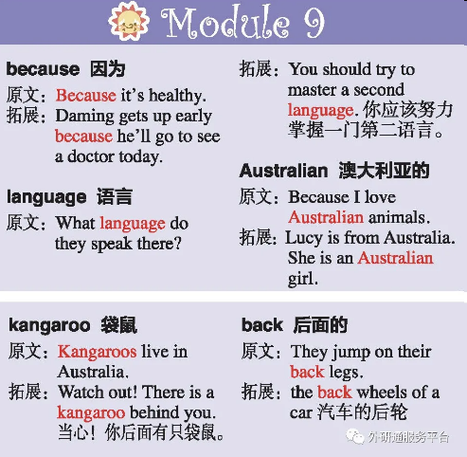
Module9 Unit1 Why do you like Australia?
Module9 Unit2 Kangaroos live in Australia.

