Slide 1

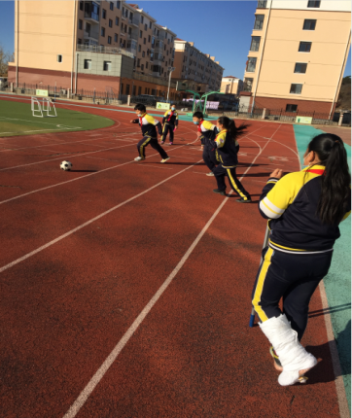
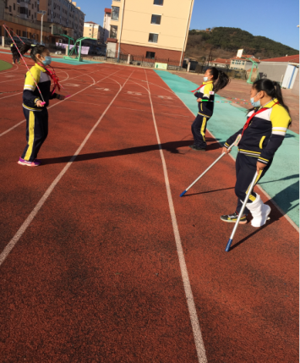
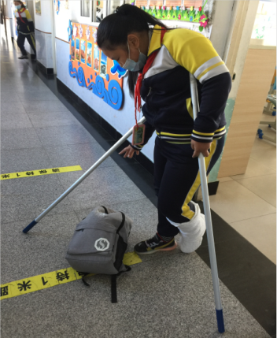

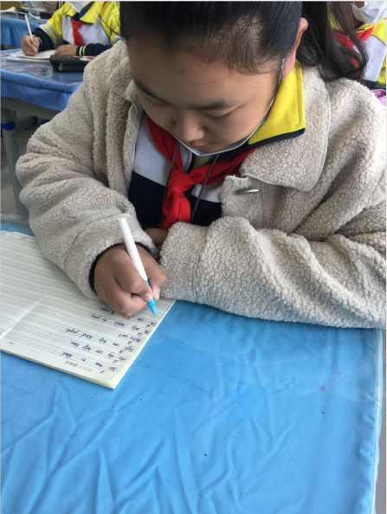
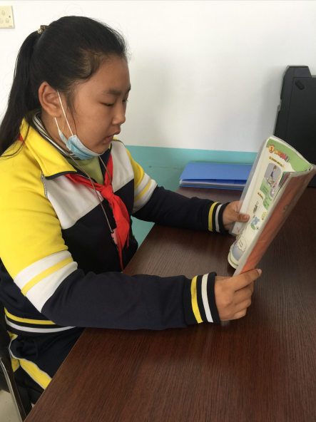
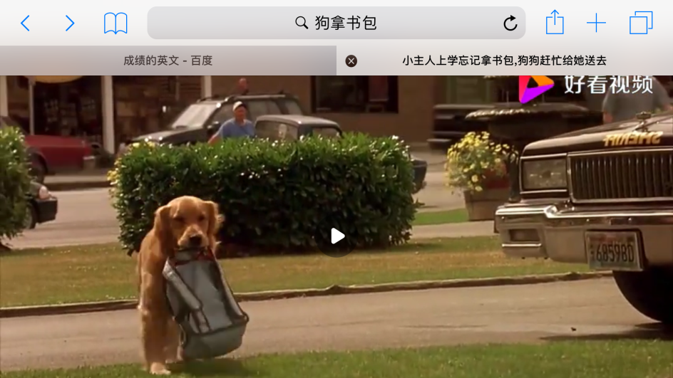
Look and say.
What could\couldn't she do?
Then, she couldn't ... , but ... could ... .
play football
skip
carry the bag
write
read
help her

Slide 2
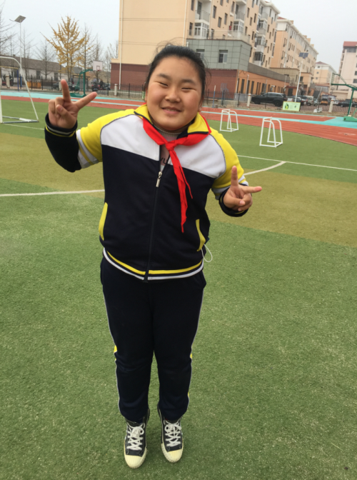
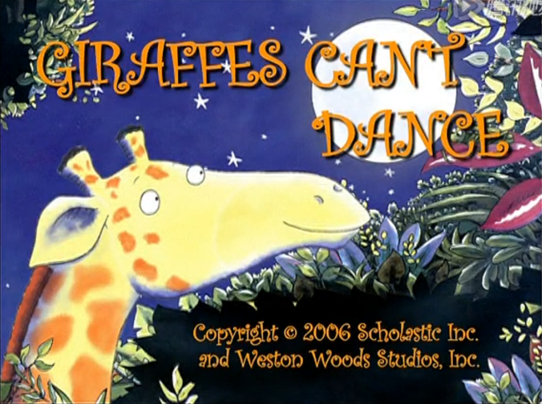
Look and say.
She couldn't _______ then,but she can ________now.
play football
skip
carry the bag

Slide 3


Slide 4

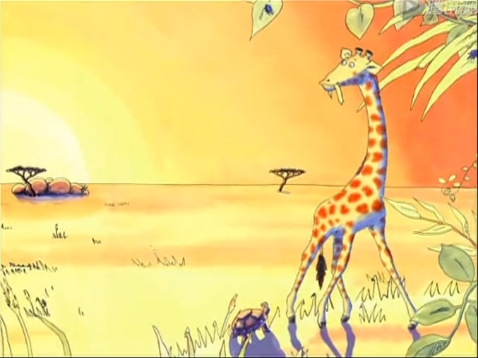

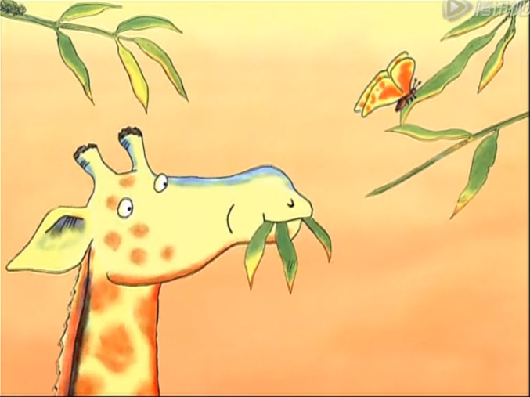
Gerald was a tall giraffe, but his legs were rather thin.
杰拉德是只长颈鹿，可惜腿瘦得骨头连着皮。
He was very good at standing, he could eat the leaves easily.
他静静站立十分优雅，抬头就能吃到树上的叶子。

Slide 5
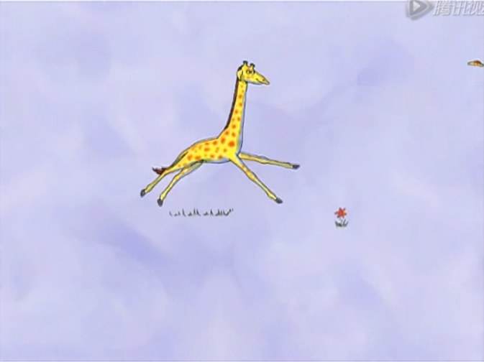
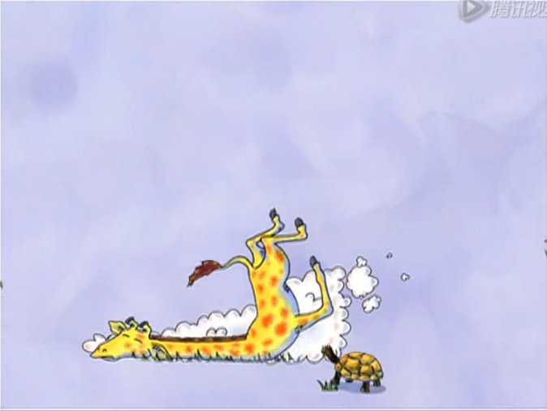
He couldn't run fast.
他不能跑动起来。
When he did that ,he fell at the knees.
每当他这样做，就会摔得四脚朝天。

Slide 6
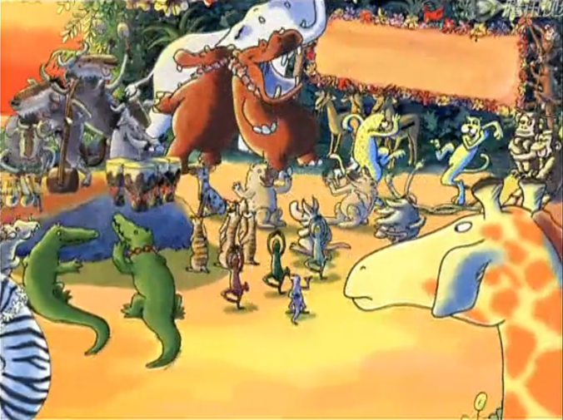
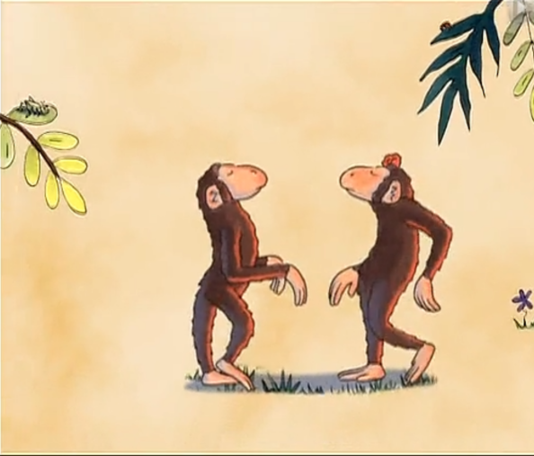
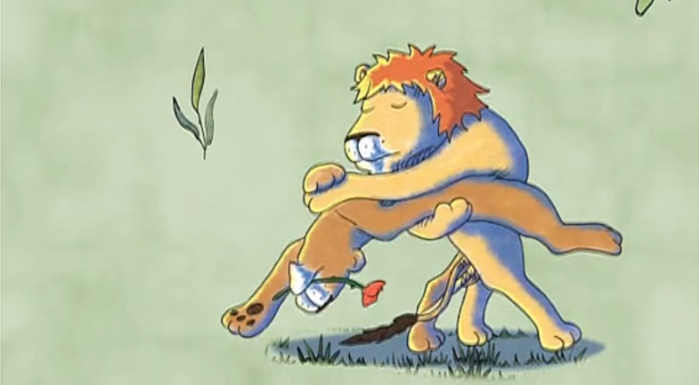
Now every year ,the animals had the Jungle Dance.But Gerald wasn't good at it.
每年动物们都举行丛林舞会.但杰拉德却不擅长。
The monkeys could do a cha-cha.
The lions could dance a tango.
猴子们集体跳恰恰。
狮子们成对跳起探戈。

Slide 7
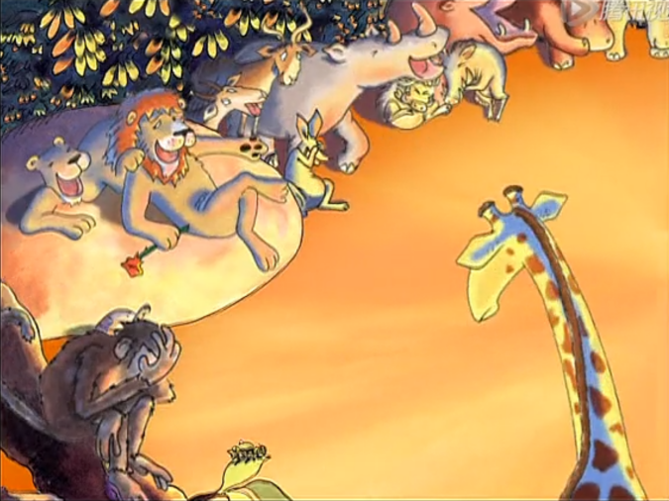
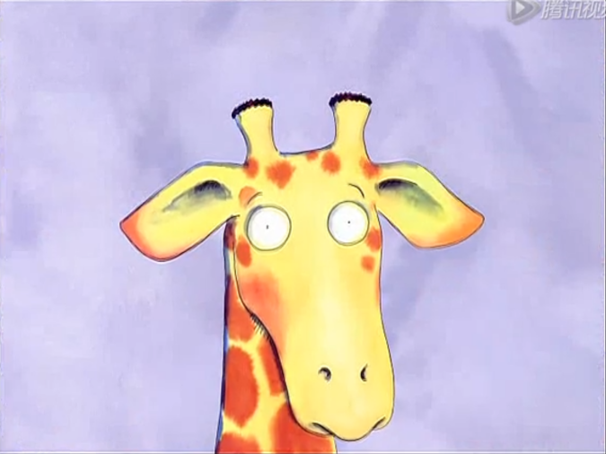
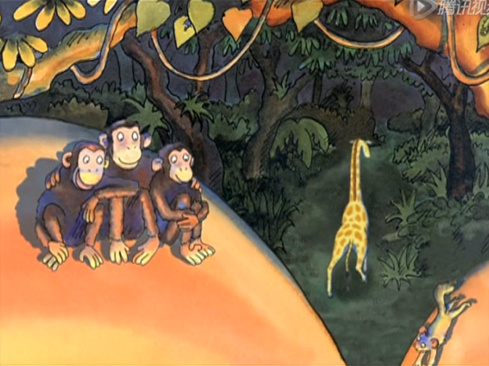
Gerald walked to the floor. But the animals all laughed,“Giraffes can’t dance, you silly fool. ”
杰拉德鼓足勇气走上舞台。“长颈鹿天生不会跳舞，你别犯傻啦！
“They’re right. I can't dance. ”
“他们说得对，我不会跳舞。”

Slide 8
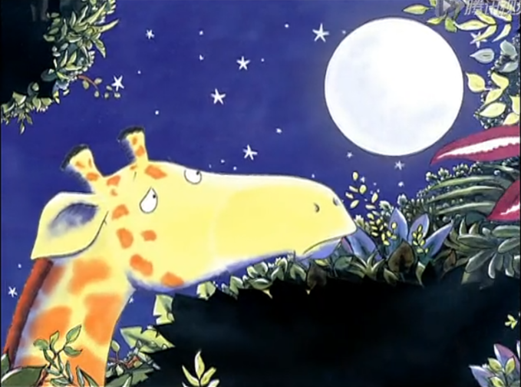
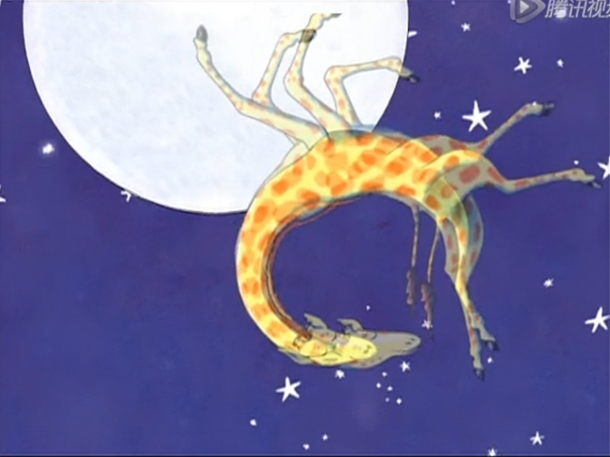
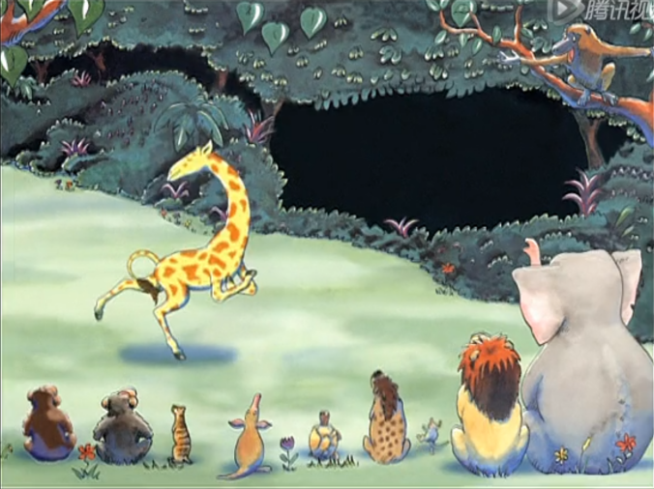
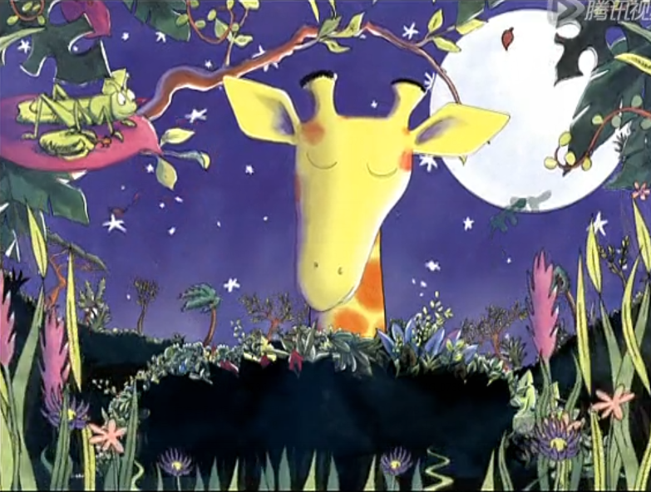
Gerald was very sad.
Suddenly he could hear the sweetest music from the trees and grass.
杰拉德很伤心。忽然间，他听到树和草发出最甜美的音乐。
He felt so wonderful, “I can dance!
Yes, I can dance!” Gerald cried.
杰拉德的感觉非常美妙，他喊道：“我
会跳舞了！我会跳舞了！”

