Slide 1
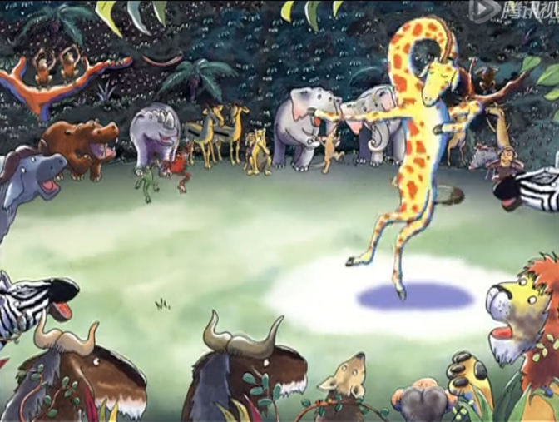
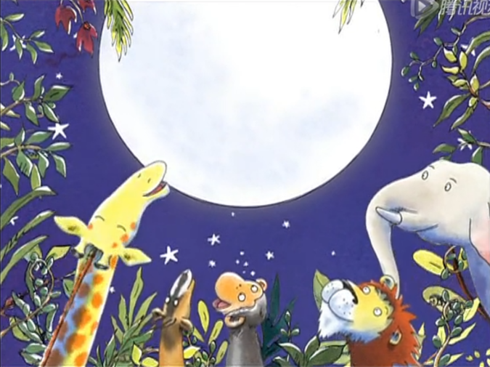
The animals shouted, “Gerald’s the best dancer!”
围观的动物大声喊道：“杰拉德成了最棒的舞者！”
“We all can dance.”He said,”When we find music that we love.”
“我们都会跳舞”他说，“只要找到我们喜欢的音乐”。

Slide 2
Read and write T or F.
Gerald was a tall giraffe, he could eat the leaves easily.But he couldn't run fast.
The animals had the Jungle Dance.But Gerald wasn't good at it.The monkeys could do a cha-cha.The lions could dance a tango.The animals all laughed,“Giraffes can't dance!” Gerald was very sad.
Suddenly he could hear the sweetest music from the trees and grass.He danced and felt so wonderful, ” I can dance !” Gerald cried.
The animals shouted,“Gerald's the best dancer!”.
T
（ ）1. Gerald was a tall giraffe.
（ ）2. He could run fast.
（ ）3. The monkeys could dance a tango.
（ ）4. Gerald is the best dancer.
F
F
T

Slide 3
We couldn't go out because of the virus, but please believe that we can defeat it! 由于疫情的原因我们不能走出去， 但请相信我们一定能战胜它！
At that time
Go around the world,
to see the animals we like!
去环球看看我们喜欢的动物！

Slide 4
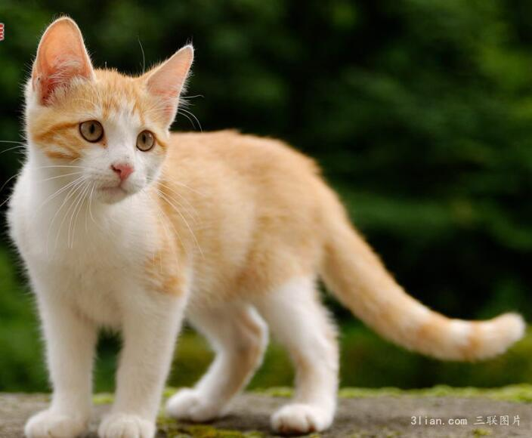
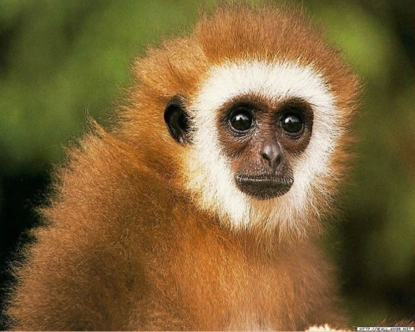
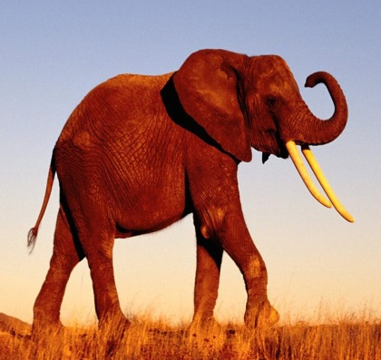
Guessing game
What animals are they? They're…
Time
They're naughty. They're thin.
They can jump very high.
They love bananas and peaches.
They live in the tress.
They’re very big and strong.
They’re gray(灰色的).
They have long nose.
They eat grass and leaves.
They live in the forest(森林）.
They can carry heavy things.
And they can spray water (喷水) with noses.
My Favourite Animal
They are lovely. They love fish.They can catch the mice. And they can climb the trees. They can play with me.
Team 1
Team 2

Slide 5
Guessing game
They’re very big and strong.
They’re gray(灰色的).
They have long nose.
They eat grass and leaves.
They live in the forest(森林）.
They can carry heavy things.
And they can spray water (喷水) with noses.
Impression(总体印象)
Appearance (外观)
Habits(习性)
Ability(能力)

Slide 6
Talk Show
My Favourite Animal
Impression
(总体印象):
My faovurite animal is …
They are …
Appearance (外观):
They are …
They eat …
Habits(习性):
They live in…
Ability(能力):
They can / can’t…

Slide 7
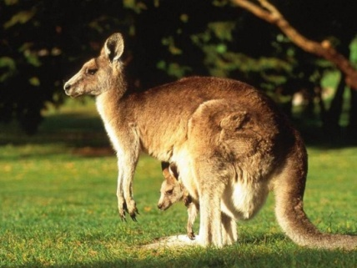
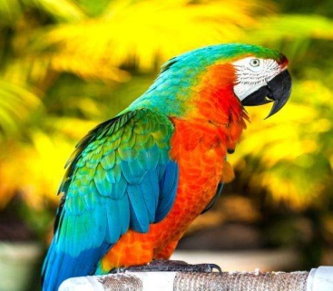
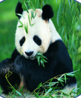
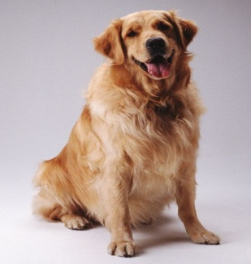
Let’s talk.
My Favourite Animal
strong
live in Australia
eat grass and leaves
jump far
jump on their back legs
big\ strong
live in the forest
eat grass \ leaves
carry heavy things spray water(喷水)
cute /beautiful
live in the trees
drink water
fly
talk with people
fat /lovely
black and white
live in China
eat bamboo
climb the trees
clever/ helpful
eat bones
help people
look after the house
run fast
Helpful Words:
in the water, on the land, in the trees…
big, small, long, short, thin, fat, strong, clever, cute, lovely, scary…
red, green, yellow, white, black, blue, brown, orange, gray, purple…
eyes, ears, nose, mouth, legs, feet, feather…
swim, run, jump, climb the trees, walk, fly…
grass, meat, fish, bones, bananas, peaches, rice, carrots, bamboo…

Slide 8
Talk Show
My Favourite Animal
Impression
(总体印象):
My faovurite animal is …
They are …
Appearance (外观):
They are …
They eat …
Habits(习性):
They live in…
Ability(能力):
They can / can’t…

Slide 9
Let’s write.
My Favourite Animal
strong
live in Australia
eat grass and leaves
jump far
jump on their back legs
big\ strong
live in the forest
eat grass \ leaves
carry heavy things spray water(喷水)
cute /beautiful
live in the trees
drink water
fly
talk with people
fat /lovely
black and white
live in China
eat bamboo
climb the trees
clever/ helpful
eat bones
help people
look after the house
run fast
Helpful Words:
in the water, on the land, in the trees…
big, small, long, short, thin, fat, strong, clever, cute, lovely, scary…
red, green, yellow, white, black, blue, brown, orange, gray, purple…
eyes, ears, nose, mouth, legs, feet, feather…
swim, run, jump, climb the trees, walk, fly…
grass, meat, fish, bones, bananas, peaches, rice, carrots, bamboo…

Slide 10
My Favourite Animal
My favourite animal is _________. They are . They live in . They can . They . I love them. | My favourite animal is _______. . . . . ____________________________.
Helpful Words:
in the water, on the land, in the trees…
big, small, long, short, thin, fat, strong, clever, cute, lovely, scary…
red, green, yellow, white, black, blue, brown, orange, gray, purple…
eyes, ears, nose, mouth, legs, feet, feather…
swim, run, jump, climb the trees, walk, fly…
grass, meat, fish, bones, bananas, peaches, rice, carrots, bamboo…

Slide 11
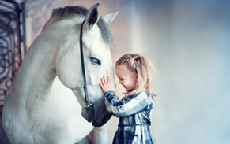
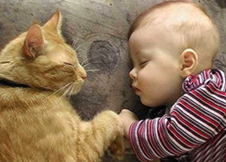
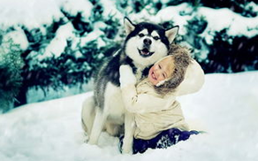
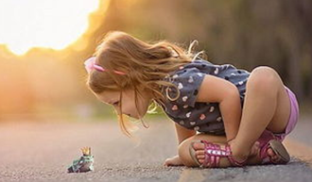
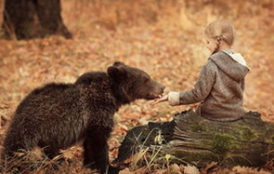
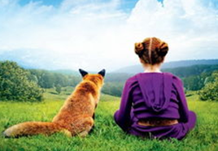
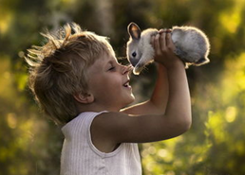
爱护动物，共享美好世界！
Share a peaceful world together!
Wherever you are,
Human and animals' abilities are limited.
But is not.
无论身处何方，人与动物的能力是有限的，
但爱是无限的!
love

Slide 12
Homework
To write the words and sentences
B. Describe your favourite animal
to your parents.
(向父母描述你最喜欢的动物)

