Slide 1
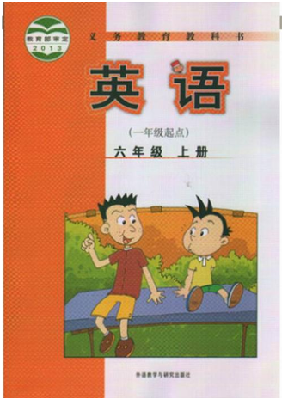
小学英语六年级上册教材
思维导图汇编
小长山岛镇中心小学 英语组

Slide 2
于阳

Slide 4
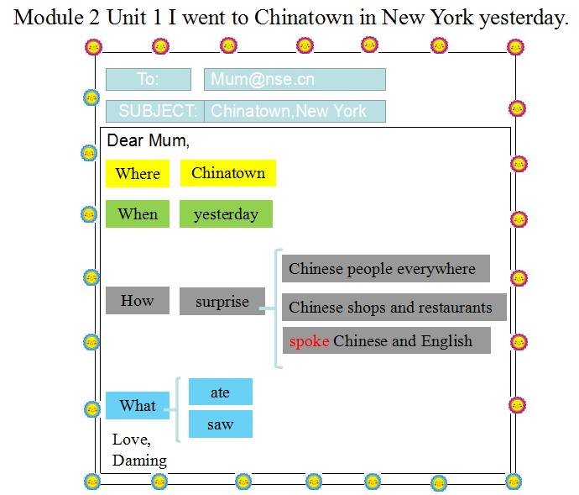
史海霞

Slide 5
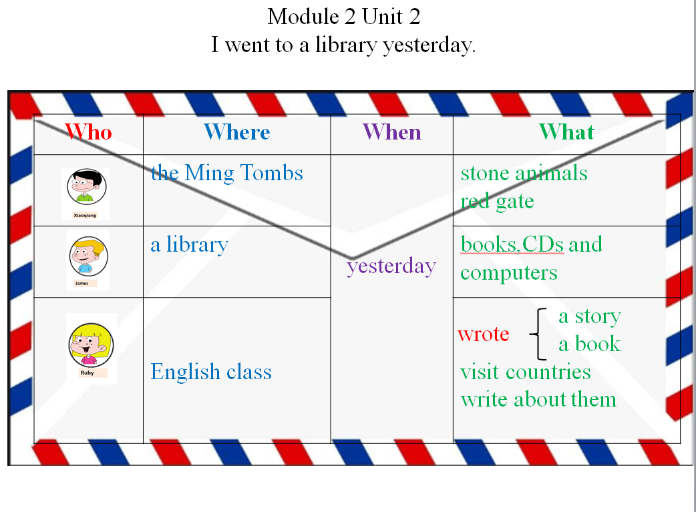
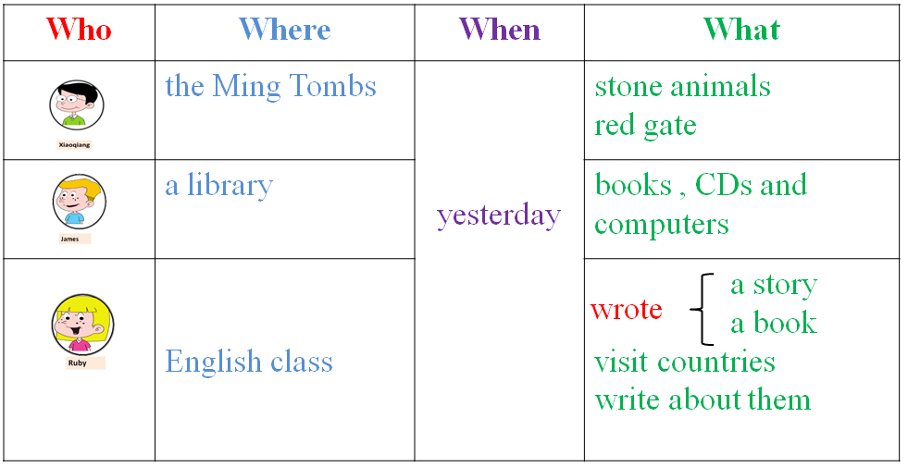
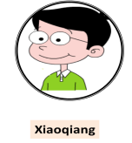
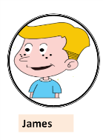
Module 2 Unit 2
I went to a library yesterday.
Who | Where | When | What
 | the Ming Tombs | yesterday | stone animals red gate
 | a library |  | books,CDs and computers
 | English class |  | a story a book visit countries write about them
wrote
史海霞

Slide 7
朱宏琴

Slide 8
王月

Slide 9
王月

Slide 10
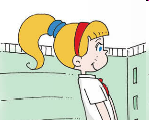
Module5 Unit1 Can I write to her?
Can I write to her?
She can speak some English.
Pen friend
Of course.
You can write to her in English.
Can… ?
Of course/Yes
Sorry/No
want / a pen friend from / pretty
I / She / He can
like / pleased
…can…
吴巧丽

Slide 11
Module5 Unit2 I want a Chinese pen friend.
phone friend
Pen friends
Name | From | Can/can’t | Want
Carol | US | can speak English and some Chinese | a Chinese pen friend
Tingting | China | can speak Chinese and English | a pen friend from the UK
Brian | London | can speak English can’t speak Chinese | new friends from China
... | ... | ... | ...
French
吴巧丽

Slide 12
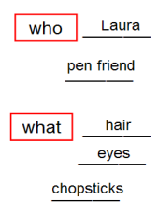
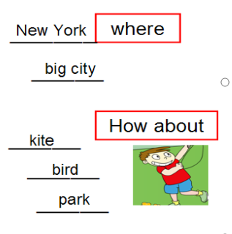
have got
Module 6 Unit 1 I ___________ some Chinese chopsticks.
has got
马晓丽

Slide 13
haven’t got
Module 6 Unit 2 I ___________ got a book about the US.
Dear Laura,
___________
Miss
What
a book about the US
photos of New York
a poster
Miss Lin
____________________
____________________
________
Who
________
When
starts at 8
finishes at 3:30
___________
___________
Your friend,
Lingling
马晓丽
___________
___________

Slide 14
王月

Slide 15
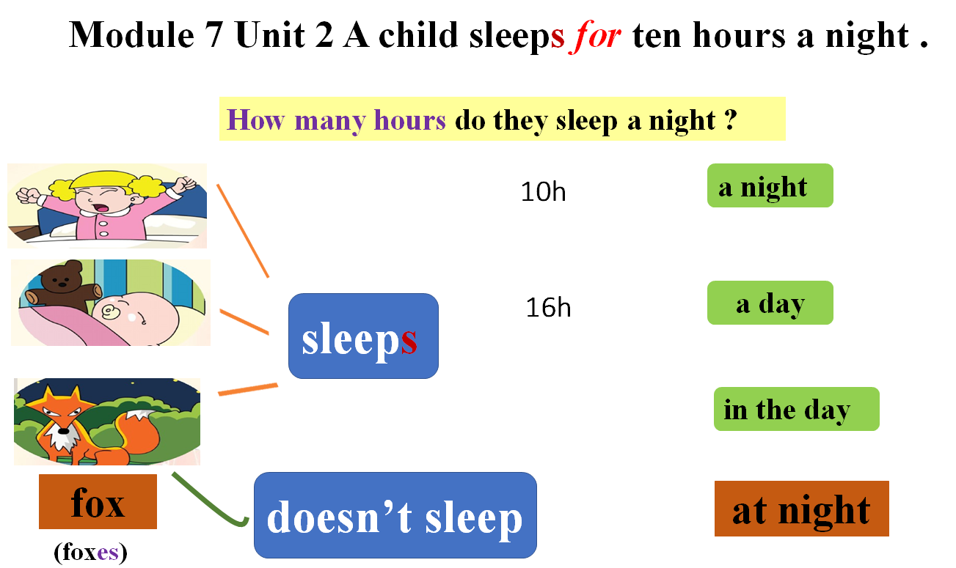
王月

Slide 16
邵琦

Slide 17
邵琦

Slide 18
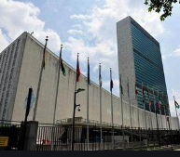
Module 9 Unit 1 Do you want to visit the UN building?
make peace
the UN
193 member states
who
where
in New York
how tall
beautiful , big , tall , important
167metres
what
马晓丽
Group U
Group N

Slide 19
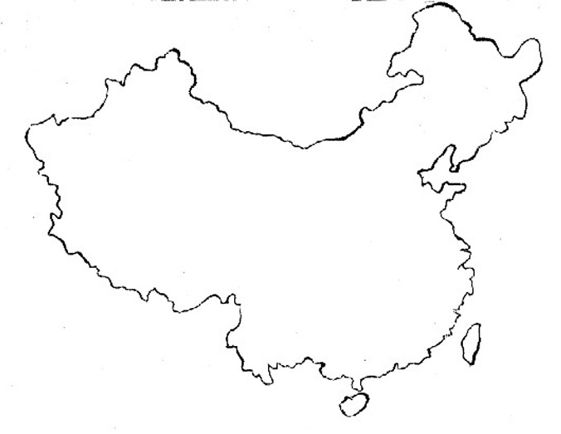
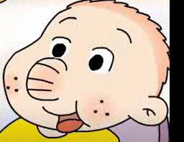
Module 9 Unit 2 I want to go to Shanghai .
Lots of beautiful places to go in China .
I want to go to …
Shanghai
big
famous
Guilin
Kunming
beautiful
in the south of China
a beautiful lake
mountains and lakes
马晓丽

Slide 20
吴巧丽

Slide 21
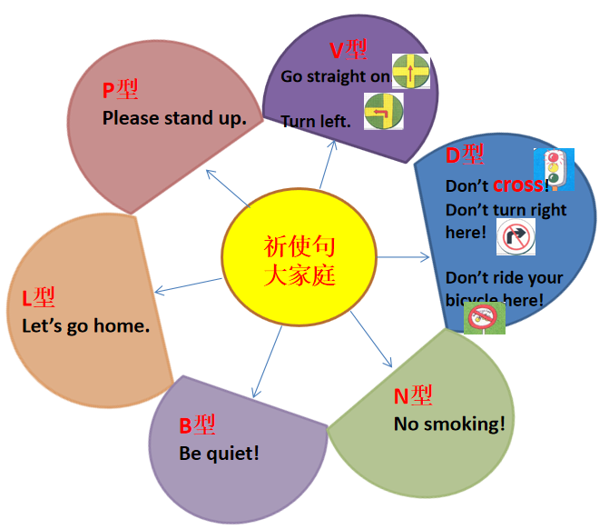
Module10 Unit2 Go straight on.
吴巧丽

