Slide 1
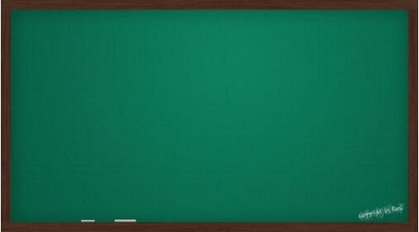
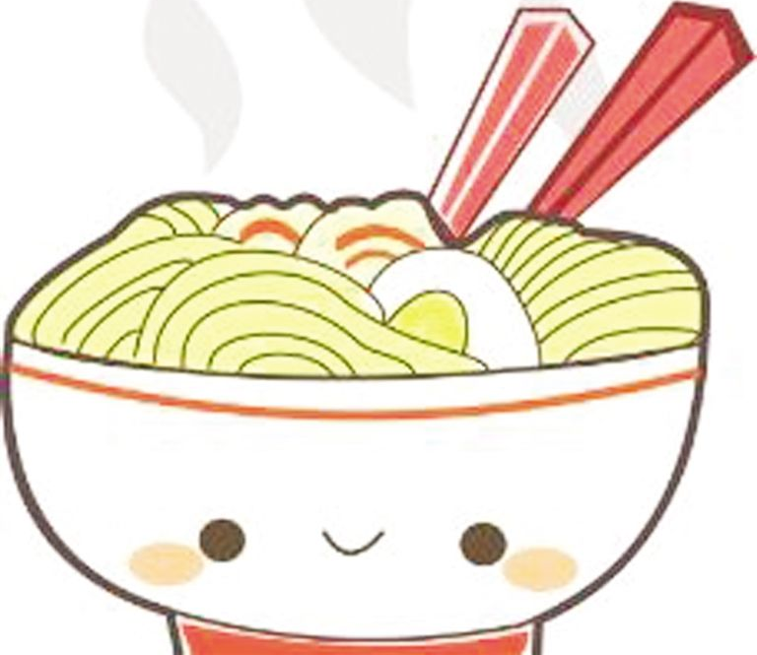
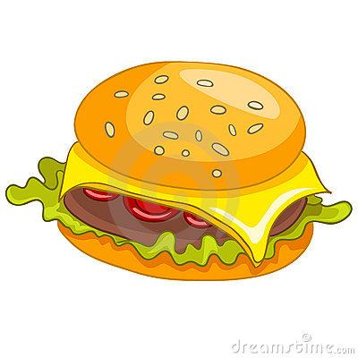
Module1 Unit 2
I'm eating hamburgers and chips.
W
noodles
Chinese fast food
W
I'm eating…
hamburgers/ chips
W
English fast food
主备人：宋媛媛

Slide 2
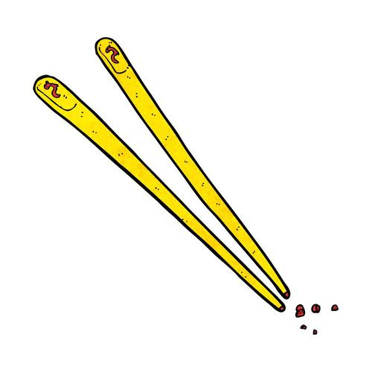
Module1 Unit 1
Do you use chopsticks in the UK?
noodles
chopsticks
W
W
Do you want…?
use
hamburgers/ chips
a knife and fork
主备人：宋媛媛

Slide 3
Module2 Unit 1 We're making a cake .
What are you doing ?
We're making a cake .
am
动ing
主语
＋
is
＋
are
主备人：韩冬梅

Slide 4
Module2 Unit 2 I'm watching TV .
What are you doing ?
I'm...
water----watering
lovely
am
is
are
W
be
主备人：韩冬梅

Slide 5
Module3 Unit 1 These ducks are very naughty.
What are these?
They’re…(复数)
What are those?
What is this?
It’s a…(单数)
What is that?
主备人：王双

Slide 6
Module3 Unit2 The ducks are playing in the rain.
These
复数+s
are
+
doing
Those
主备人：王双

Slide 7
Module4 Unit I can jump far.
Yes , I can..
W
Can you … ?
No, I can’t .
I can do...
I can’t do.. .
主备人：王双

Slide 8
Module4 Unit2 What can you see?
What can you see?
It can ....
I can see a ….
It can’t ...
主备人：王双

Slide 9
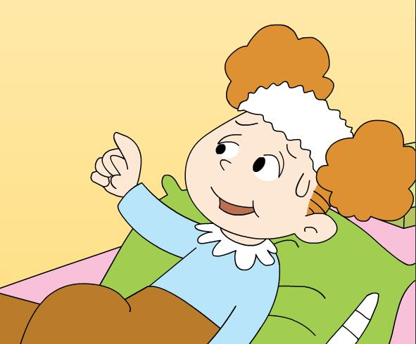
Module 5 Unit 1 Can I have an ice cream ?
Can I have a drink , please ?.
Yes. Here you are .
Can I watch TV, please ?.
Yes. You can.
Can I have an ice cream, please ?.
No, you can’t .
Can I … ?
Yes. You can .
No. you can’t .
主备人：宁思琳

Slide 10
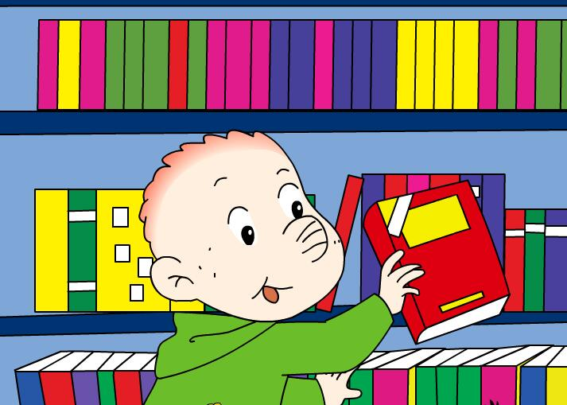
Module5 Unit 2 Can I come in ?
Can I come in ?.
Yes. please.
Can I read this book ?.
Yes. You can.
Can I … ?
Yes. You can .
No. you can’t .
主备人：宁思琳

Slide 11
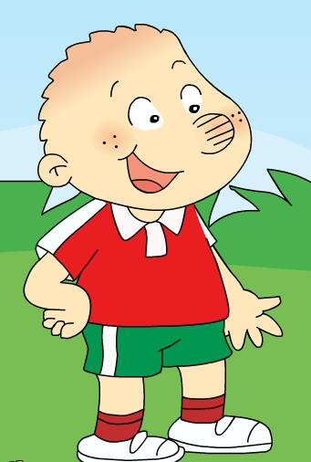
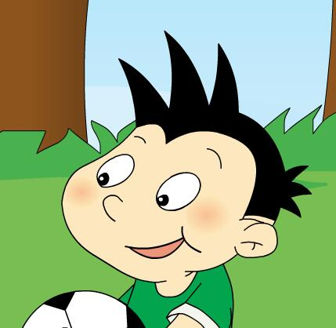
Module 6 Unit 1
I’ve got new shorts and new shoes .
I’ve got new shorts and new shoes .
I’ve got a new football .
I’ve got = I have got .
主备人：宁思琳

Slide 12
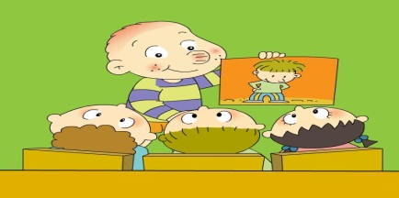
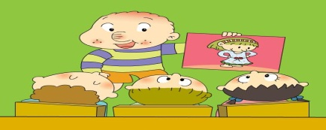
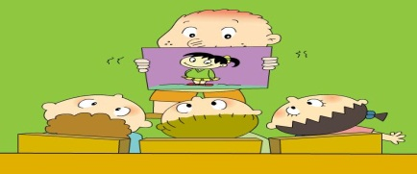
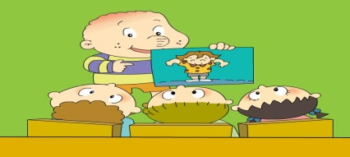
Module 6 Unit 2 He’s got a new shirt.
He’s got new trousers.
She’s got a new dress.
She’s got new shoes.
He’s got a new shirt.
当主语是第三人称单数时 He’s got …/ She’s got…
主备人：宁思琳

Slide 13
Module7 Unit 1
Have you got a headache?
Have you got……?
Yes, I have .
No, I haven’t.
主备人：王超

Slide 14
Module7 Unit 2
She’s got a cold.
Yes , he has .
W
Has he … ?
No, he hasn’t .
Yes, I has .
you你
Heve you… ?
No, I hasn’t .
you你们
Yes , we have .
No , we haven’t .
主备人：王超

Slide 15
Module8 Unit 1 This is Sam’s book.
is
are
单数
W
be
复数
This is…
They are…
主备人：王超

Slide 16
Module8 Unit 2
Is this your grandma’s umbrellas?
Yes , it’s…...
W
Is this … ?
No, it isn’t..
Yes, they are.
Are they… ?
No, they aren’t.
主备人：王超

Slide 17
Module9 Unit 1 I’m going to do long jump.
I am
He/ She is
We are
be going to +动词原形
do long jump
run a race
do high jump
I am going to

Slide 18
Module9 Unit2 I am going to be a driver.
What are you going to be?
driver
doctor
nurse
teacher
policeman
footballer
I am going to be

Slide 19
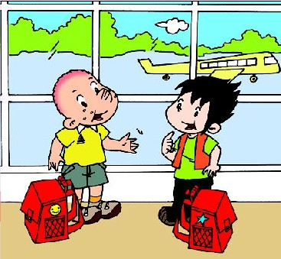
Module10 Unit1 Are you going to go to Hong Kong?
Are you going to go to Hong Kong?
Yes, I am.
No, I’m not.
What are you going to do?
I’m going to …

Slide 20
Module10 Unit 2 What are you going to see?
What are they
you going to do ?
What is he going to do ?
she
She/he is going to....

