Slide 1
Module 2 Unit2
They sell many different things.

Slide 2
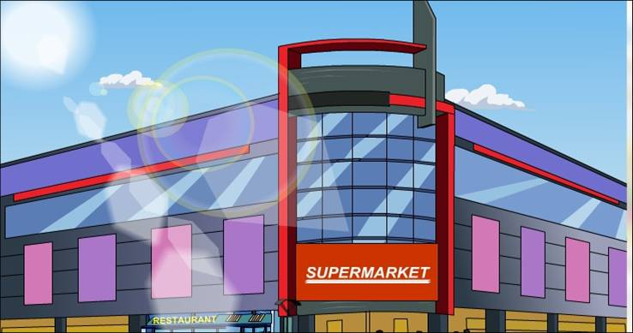
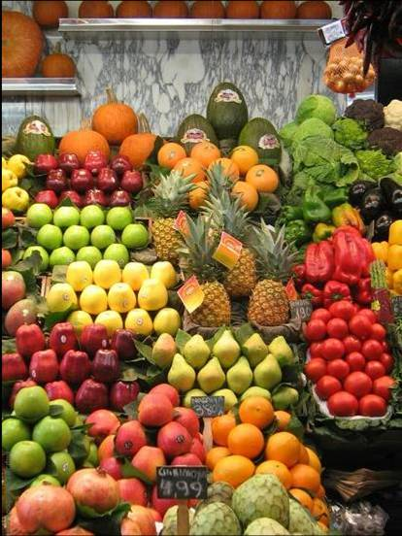
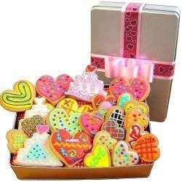
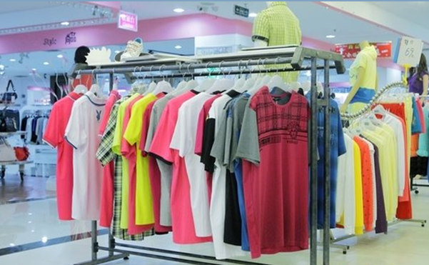
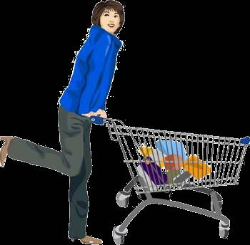
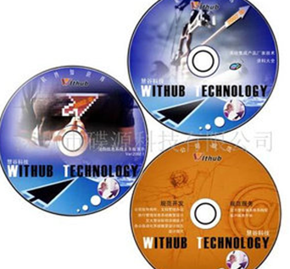
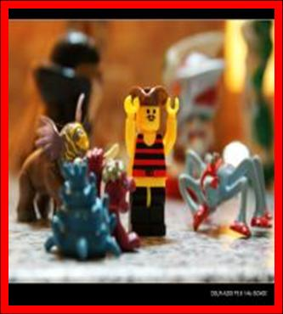
There is\ are….

Slide 3
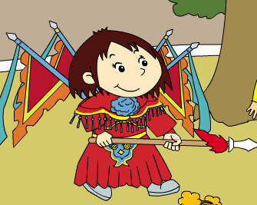
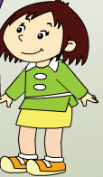
Look and answer.
Does Lingling look different?
different
clothes

Slide 4
Watch and answer.
What’s Lingling doing?
She is playing Beijing Opera.(京剧)

Slide 5
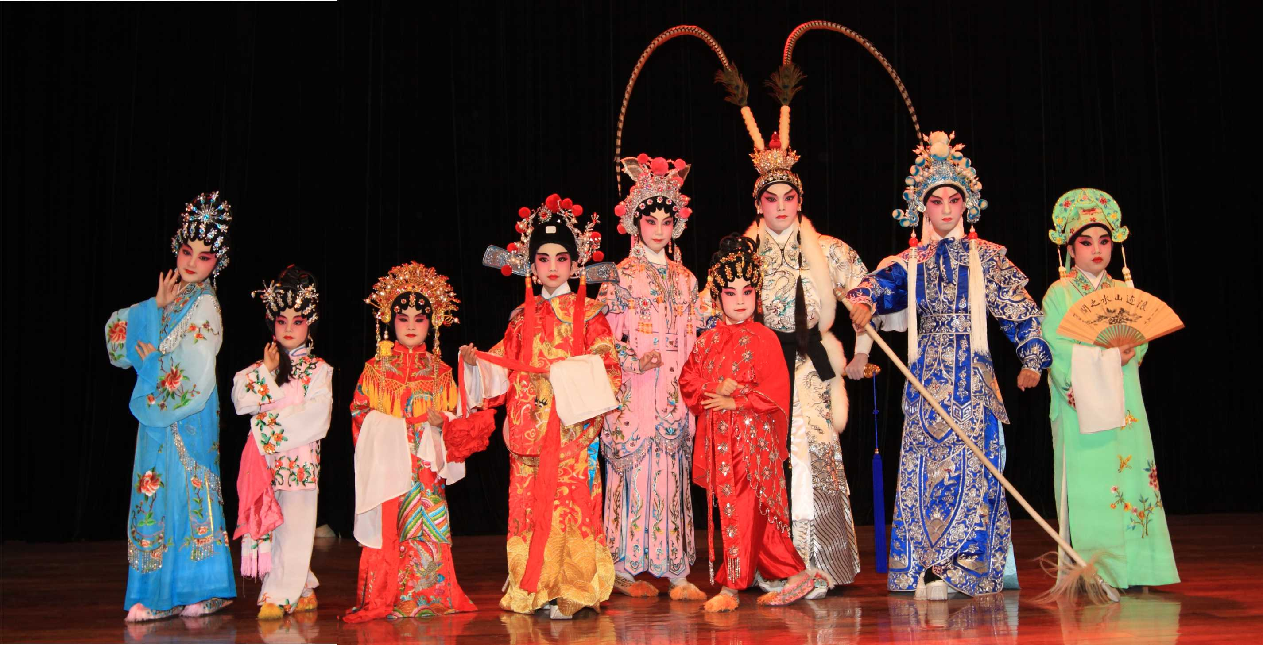
Beijing Opera
Traditional Culture

Slide 6
Task
使用一般现在时介绍自己喜欢的商店。

Slide 7
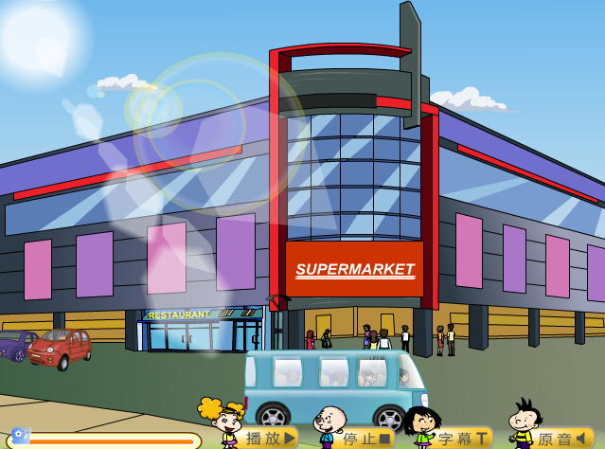
Watch and choose.
What 's the text about?
It’s about_____________.
English supermarkets
A.
Chinese supermarkets
B.

Slide 8
Listen and imitate.
Then choose.
A
1.What are English supermarkets like?_______
They are very big. B.They are small.
2.What do they sell? They sell_________. (多选)
clothes B.toys C.books D. food E.CDs
3.Are there restaurants at the supermarket sometimes?
A.Yes, there are . B. No, there aren`t.
A
B
D
E
A

Slide 9
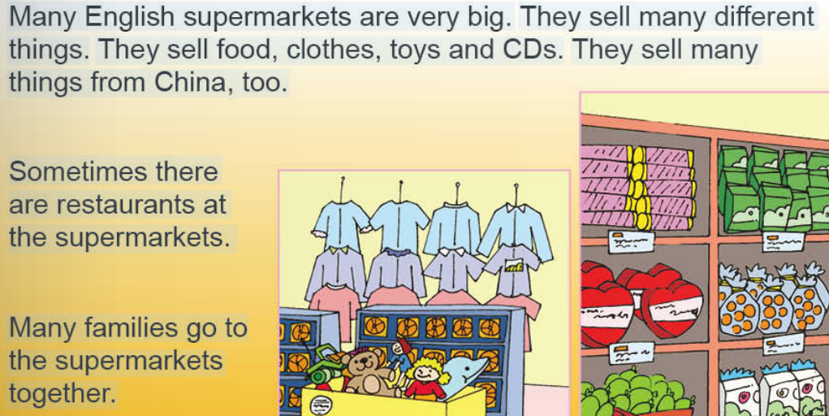
Read and complete.

Slide 10
Let`s retell the text!

Slide 11
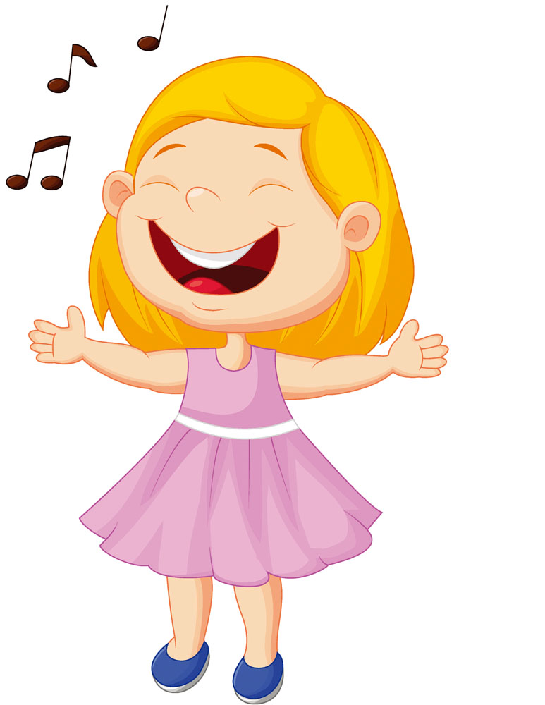
Let’s chant!
Read and answer.
Supermarkets sell sweets.
They sell fruit, too.
Some sell nice clothes
for me and for you.
They sell many different things
like CDs and toys.
They sell lots of goodies for
all of us, girls and boys.

Slide 12
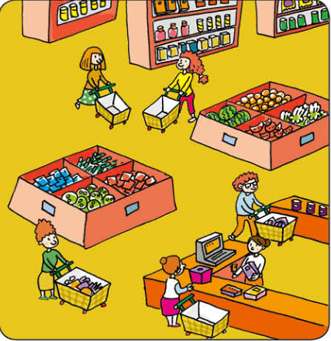
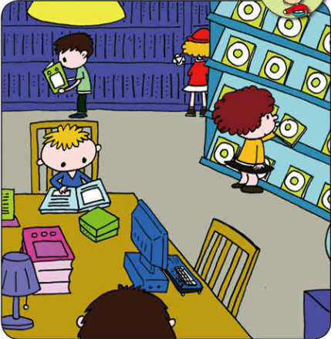
Read and write.
This supermarket is very big.
This bookshop is very big\small.
It sells many different things.
It sells many books and CDs.

Slide 13
Read and judge T or F.
Chinese supermarkets are very convenient(方便的） for us! We can buy many different things in it! We can buy toys, food, drinks, clothes, shoes and other things. But the things are not so cheap . In the Chinese supermarket you can buy some fresh vegetables unwashed（没有被洗的）and fresh fish .
1. The Chinese supermarkets sell different things.
2. We can buy fresh fish in Chinese supermarkets.
3. The vegetables are unwashed in English supermarkets.
T
T
F

Slide 14
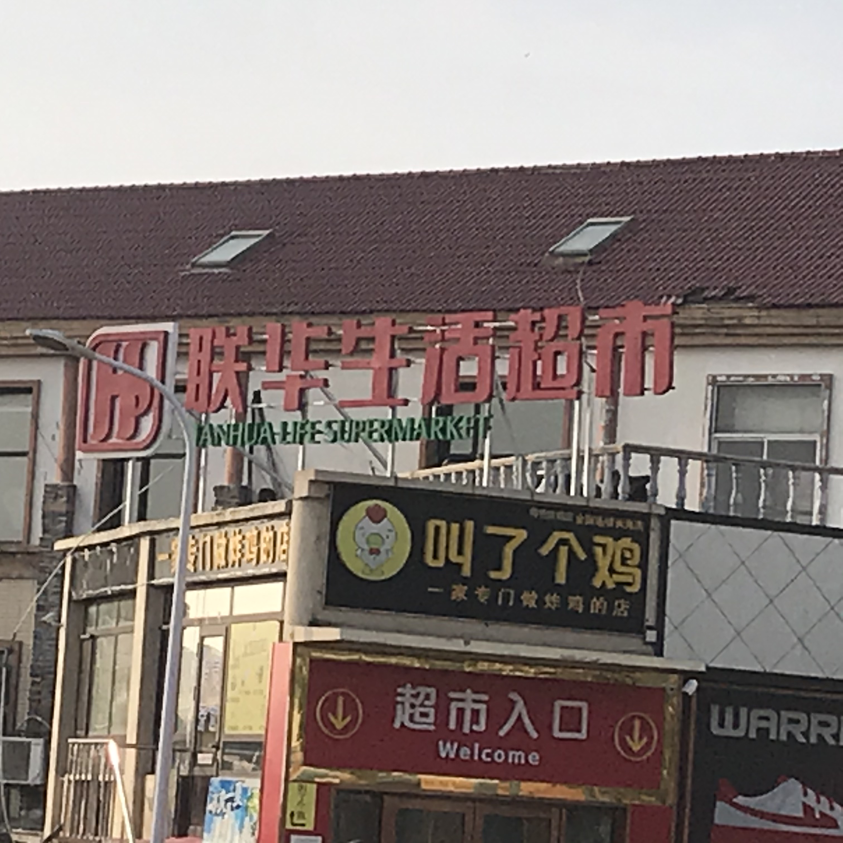
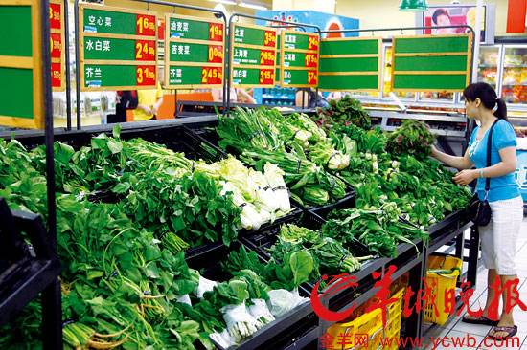
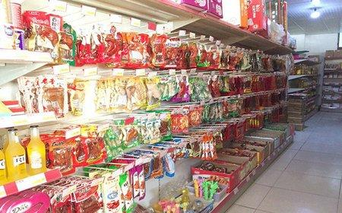
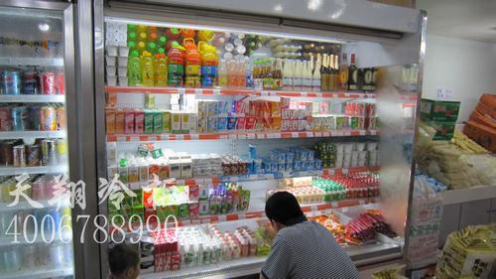
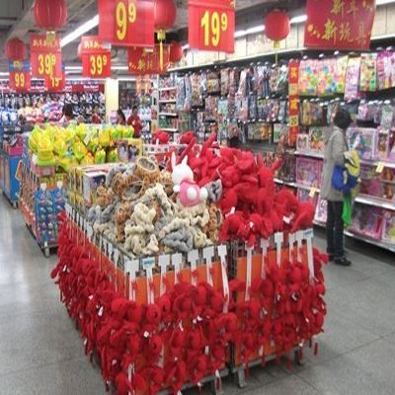
Let`s talk!
It sells....

Slide 15
Let`s write!
My Favourite Shop
This is my favourite shop. It`s small. It sells many different things. It sells food. And it sells small toys.
I like it very much .

Slide 16
Let`s write!
My Favourite Shop
This is my favourite shop. It`s______. It sells________________.
____________. And it sells____________. I like it very much.
参考词语：supermarket, bookshop, big, small ,
many different things, food, clothes ,toys, sweets, vegetables, fruit......

Slide 17
当堂检测
1.S__________there are restaurants at the supermarkets.
2.This shop is big.It _______(sell)many things.
3.Many ________(family, families)go to the supermarkets together.
ometimes
sells
√

Slide 18
Homework
1.背诵M2U2的单词和课文。
2.完成小练笔。

Slide 19
rRetell the text!t
Read and judge Tor F.
F
（ ） 1.English supermarkets are all big.
（ ） 2.They only sell different things from China.
（ ） 3.Sometimes people can have meals(饭) at the
supermarkets.
（ ） 4.Many parents go to the supermarkets with
their children.
F
T
T

