Slide 1
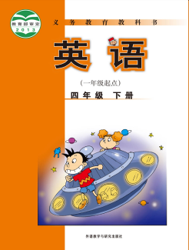
小学英语四年级下册教材
思维导图汇编
大长山岛镇中心小学 英语组

Slide 2

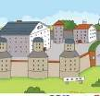


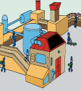



Module 1 Unit 1
Don't touch the machines, please!
Welcome to the
washes
potatoes
cuts
machines
puts cirsps in the bag
王钟慧
dangerous
Wait! You can each have a bag of crisps.

Slide 3


Module 1 Unit 2
Don't feed the fish!
play the ball games here!
walk on the grass !
Don't
feed the fish!
in the park
...
talk!
Don't
write on the book!
...
in the library
祈使句,表示要对方做或不做某事、带有祈使语气的句子。
王钟慧

Slide 4

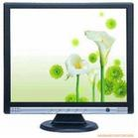



Module 2 Unit 1
It's cheap.
Granma's computer
Amy's computer
cheap
beautiful
pink
big
helpful
expensive
beautiful
Is it...?
No,it's ...
It's not ...,but it's...
王钟慧

Slide 5



Module 2 Unit 2
It costs one hundrend and eighteen yuan.
one hundred and eighteen yuan
It costs
nineteen yuan
one yuan
王钟慧

Slide 6

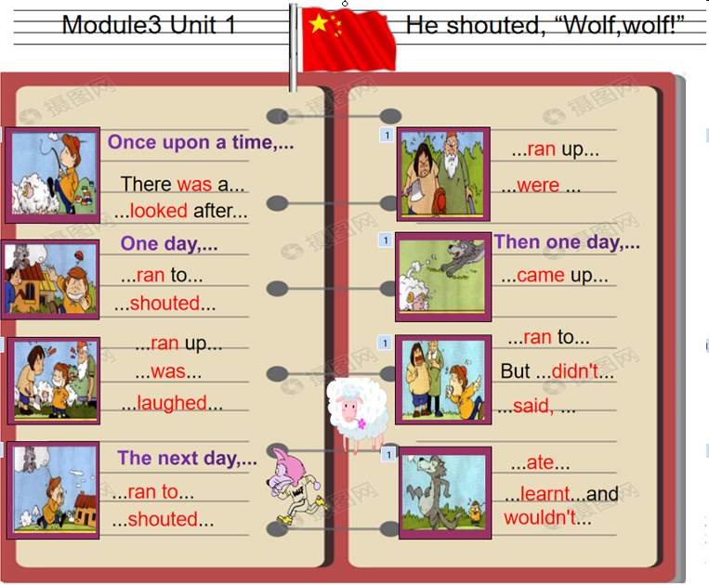
杨蕉宇

Slide 7
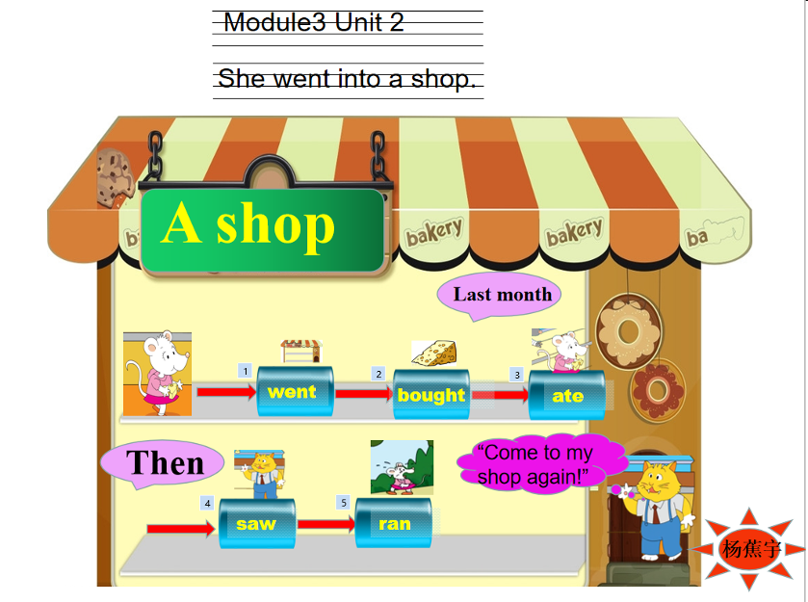

Slide 8
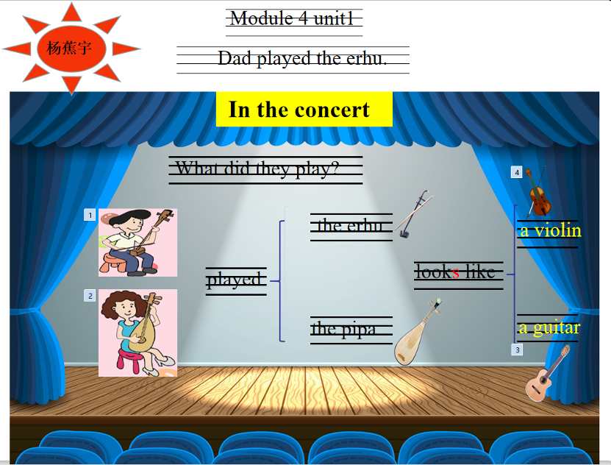

Slide 9
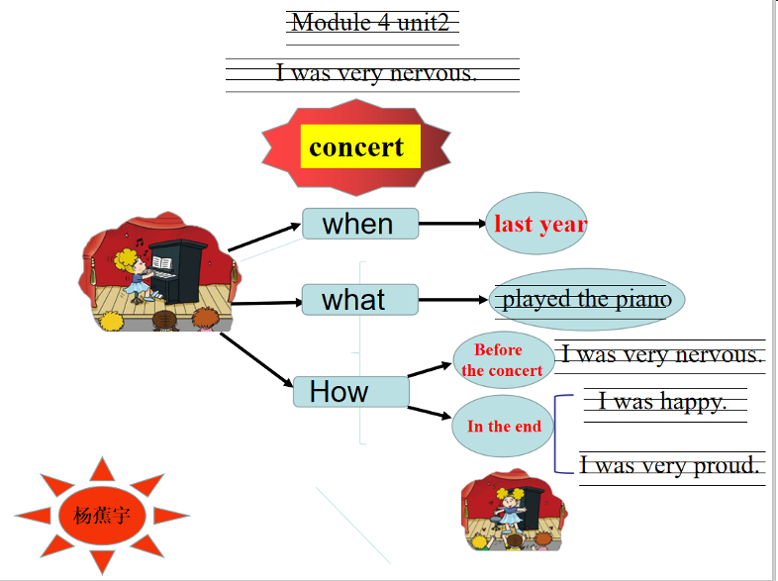

Slide 10







surprise
Module 5 Unit 1 We are having a party.
What are you doing?
We are having a party.
What's happening now?
Tom is singing.
hear
杨春莲

Slide 11




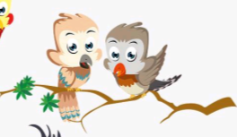
Module 5 Unit 2
He's drawing books and birds.
= 3'
= 2'
= 1'
Dear Dad,
You're so special.
Thank you for everything.
Love,
Daming.
Dear Dad,
You're so special.
Thank you for everything.
Love,
Daming.
Father's Day
special
message
杨春莲
备注：M5U2板书动态变化－1

Slide 12
Module 5 Unit 2
He's drawing books and birds.
= 3'
= 2'
= 1'
Father's Day
special
message
杨春莲
备注：M5U2板书动态变化－2

Slide 13




Module 6 Unit 1
I'll draw the pictures.
will
you
draw the pictures.
What
do?
--
--
--
--
--
--
--
--
--
--
write the reports.
--
--
--
--
I'll
--
--
--
--
--
--
--
--
cut the paper.
--
--
--
--
--
--
stick the pictures.
Great!
杨春莲

Slide 14








Module 6 Unit 2 Let's have fun this Saturday.
meet
A Fun Day
o'clock
When
Where
at 10
this
Saturday
park
school
west
east
next to
What
杨春莲
备注：云朵、风筝、小草均为评价机制内容

Slide 15
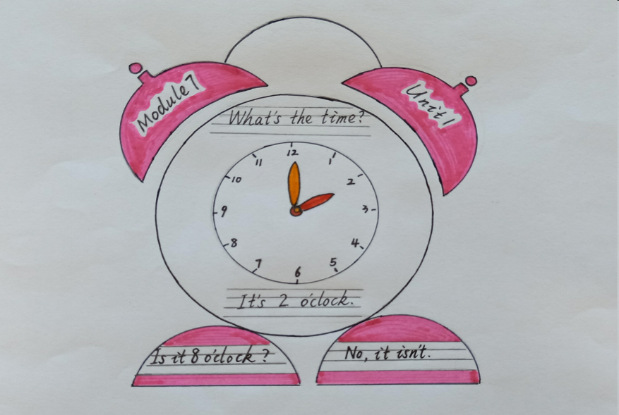
傅海华

Slide 16
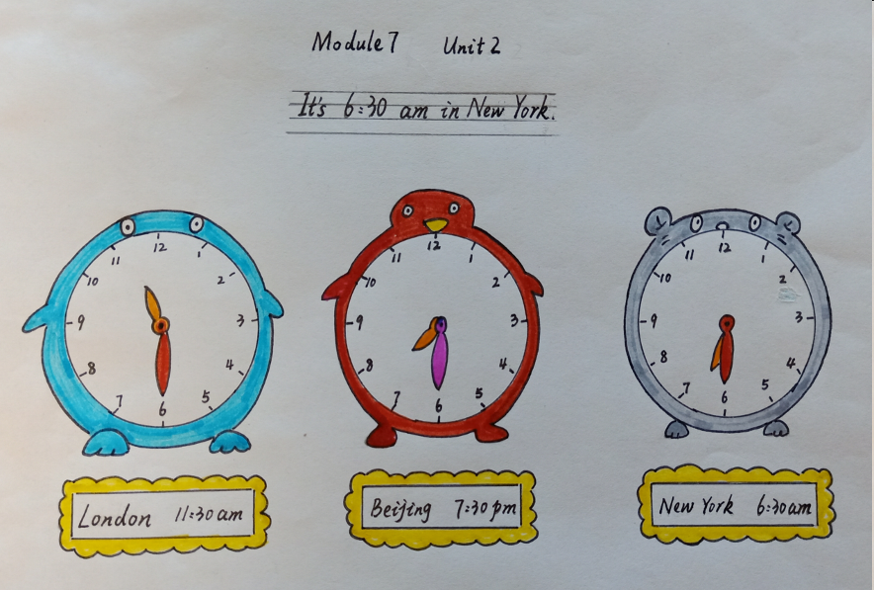
傅海华

Slide 17
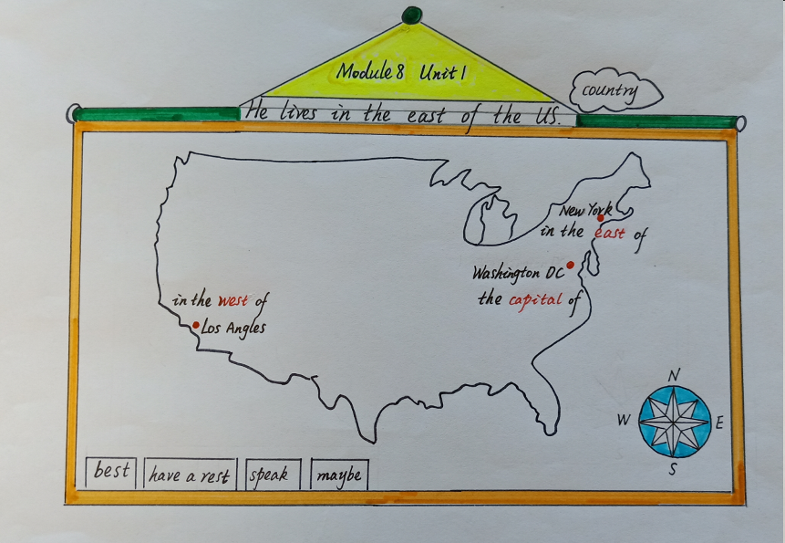
傅海华

Slide 18
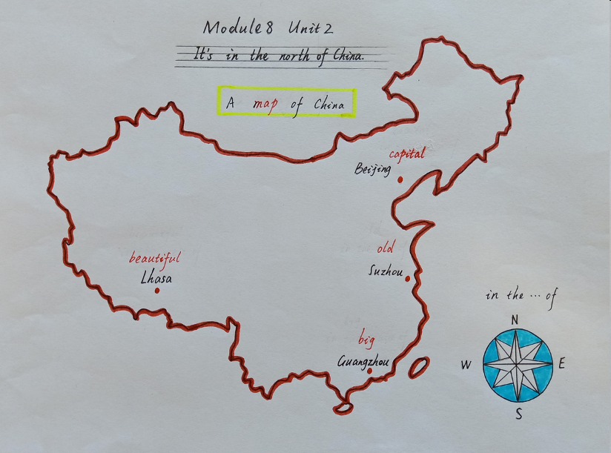
傅海华

Slide 19


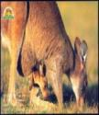


Module 9 Unit 1
Australia?
Why do you like
kangaroos and koalas?
I love Australian animals.
Because
they are very very cute.
language
宋燕

Slide 20

Module 9 Unit 2
Kangaroos live in Australia.
Why
live
Where
Because
helpful
drink
nice
What
has got
eat
have got
宋燕
back

Slide 21
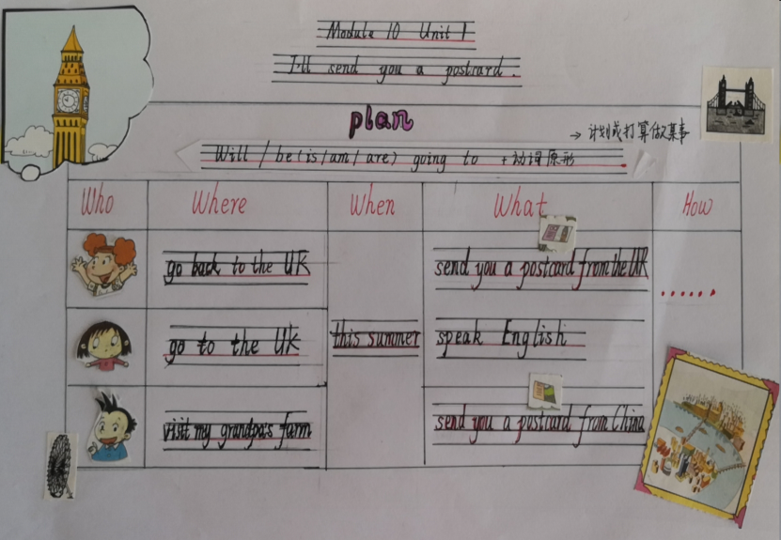
骆文芳

Slide 22
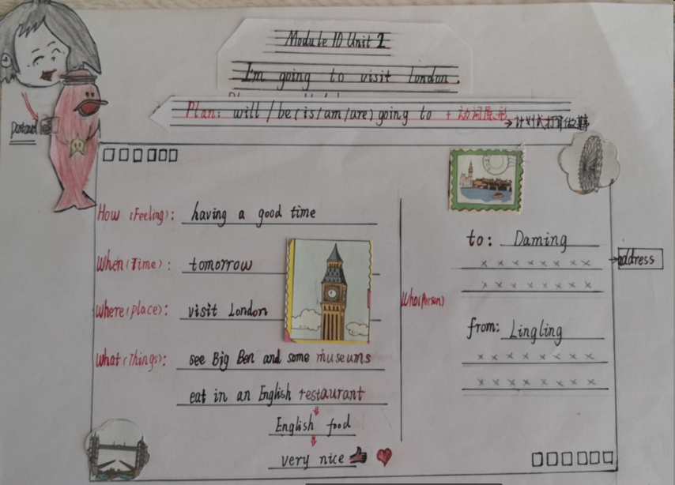
骆文芳

