Slide 1
Revision of Module 3
Describing the scene .
小长山岛镇中心小学 王月

Slide 2
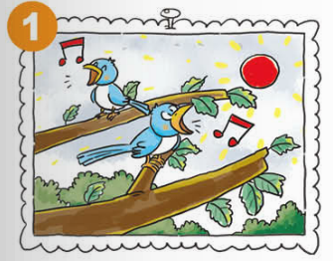
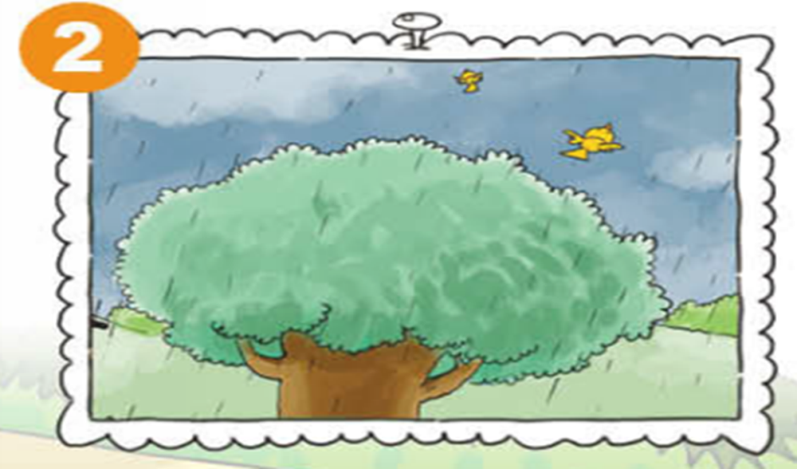
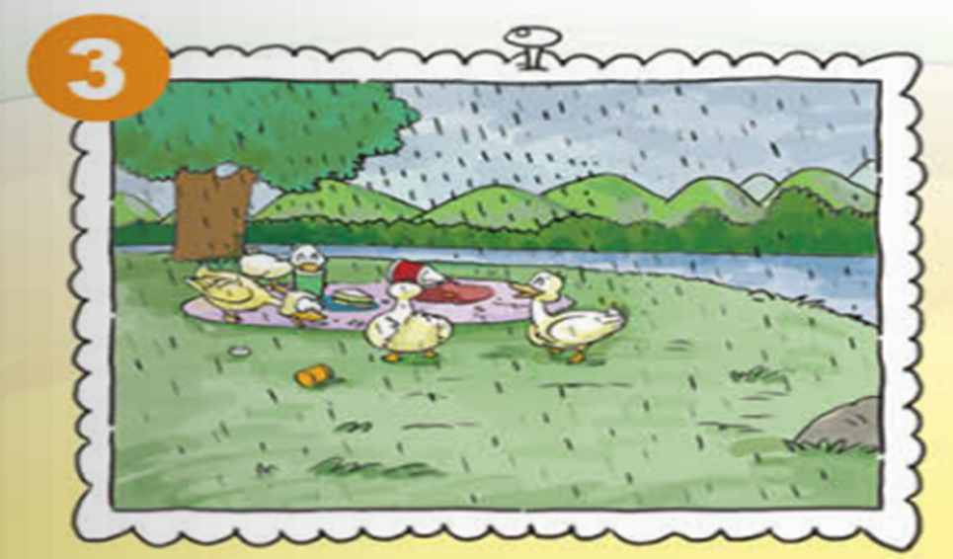
In Photo ... , it’s ...
The birds / ducks are –ing ...

Slide 3
Task
运用一般过去时或现在进行时描述场景或事件。
-ed
be+doing

Slide 4
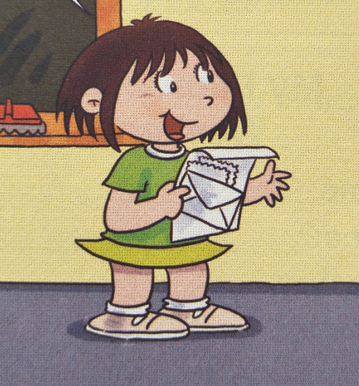

Slide 5
Read and do !
谈论过去发生的
事情
Daming’s Trip Card
Place | Weather | Activities | Feelings
 | Before the rain
 | When it rained
 | After the rain
saw a big lake and ducks
took some photos
had a funny day
the park
ran quickly to hide
left food
went home
用在:一般过去时
the simple past tense

Slide 6
动词过去式的变化
动词过去式, ed来结尾;
一般直接加, 见e只加d;
辅y结尾y变i, 再加ed;
重读辅元辅, 双写尾字母，
最后结尾加ed;
特殊变化单独记！
yesterday
last ...
in 1990
just now
this morning
... ago
once upon a time
…
did / didn’t

Slide 7
Talk about Daming’s trip .

Slide 8
Listen and number the pictures !
B
E
A
C
D
1.( ) 2. ( ) 3. ( ) 4. ( ) 5. ( )
描述正在进行
或发生的动作
A. B. C.
现在进行时
D. E.
be + doing
+

Slide 9
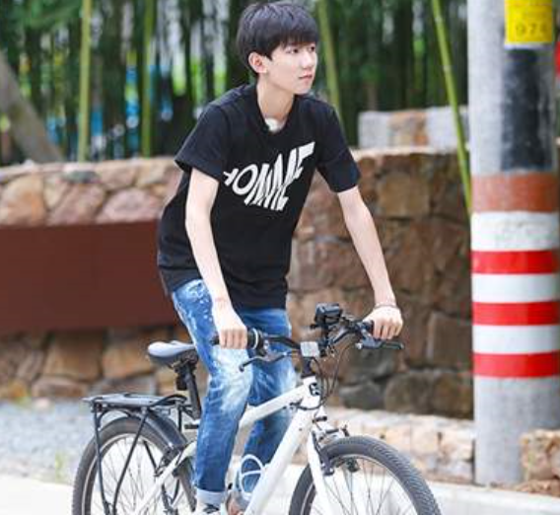
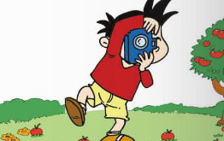
-ed
am / is /are +doing
will / be going to
past
now
future

Slide 10
Let’s do !
are flying
1.Look at this photo , the birds ____________(fly) .
2. I ________(have) a picnic last Sunday .
3.What’s she doing ? She’s _________(buy) some food .
4.It __________(rain) in Beijing tomorrow .
5.Did you _________(read) stories yesterday ?
6.What are you doing ? I _____ playing the piano now .
had
buying
will rain
read
am

Slide 11
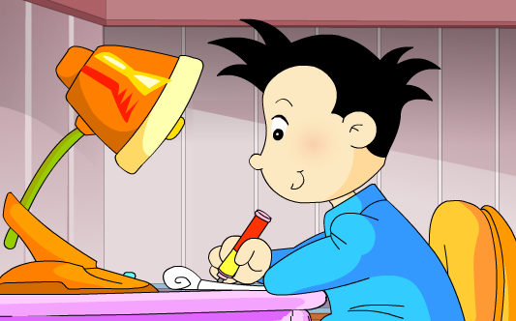
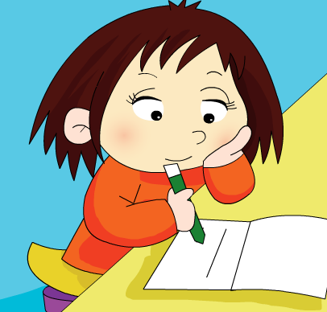
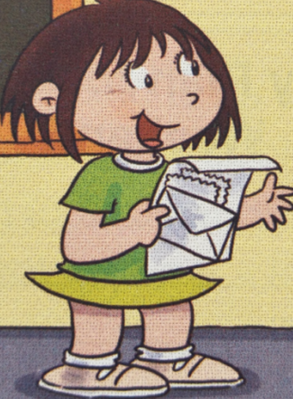

Slide 12
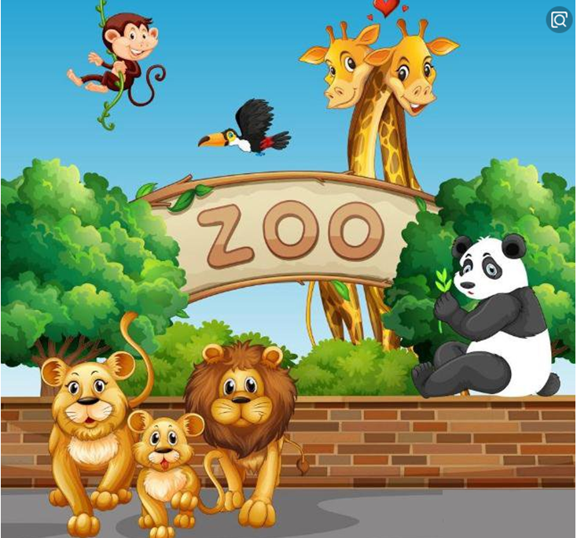
Time

Slide 13
Listen and complete the words !
Dear Daming ,
Thank you for your letter . Last Saturday , I had a funny day , too . The sun was shining . I went to the zoo with my friend . There were lots of animals in the zoo . We saw pandas , tigers , lions ... And I took some photos . Look! In this photo , the tiger is crying .
Later , we went to the library . We wanted to borrow books . But we left the library card in the zoo . So we ran quickly to the zoo . But it closed .
So we didn’t borrow books at last . But we were happy .
From ,
Lingling
----------------------
______
___________
_________________
_______
_______
____
_______
______

Slide 14
Let’s do !
判断正误 ， T / F
( )1.It was a fine day last Saturday .
( )2.Lingling took some photos in the zoo .
回答问题
3.When did they go ?
____________________________________
4.Did they borrow books at last ?
___________________________________
5.Who went to the zoo ?
__________________________________
T
T
Last Saturday .
No , they didn’t .
Lingling and her friend .

Slide 15
Describe the scenes .
(描述场景或事件。)
A: Where did you go?
B: I went to …
C: What was the weather like ?
B: It was …
D: What did you do?
B: I …
A/C/D: Did you have a good time ?
B: …
…

Slide 16
Describe the scenes .
(描述场景或事件。)
Write a letter to Daming .
现在进行时
描述场景：
What are the dog and the bird doing ?
一般过去时
描述自己的或旅行卡片上的有趣经历。

