Slide 1
Revision Module 5
Travelling Experience

Slide 2
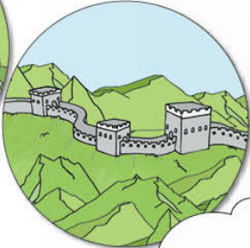
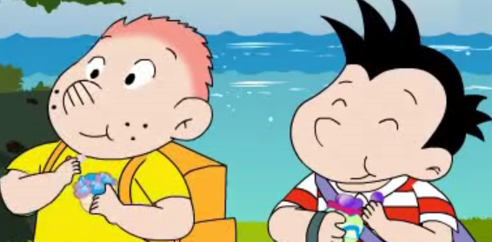
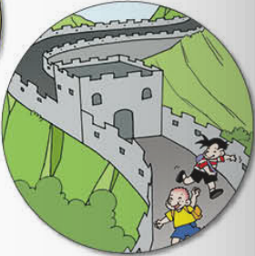
What did they do?
saw
ate
had

Slide 3
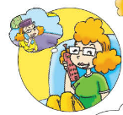
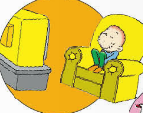
What did you do?

Slide 4
Task
介绍自己的旅行经历。
Introduce the travelling experience.

Slide 5
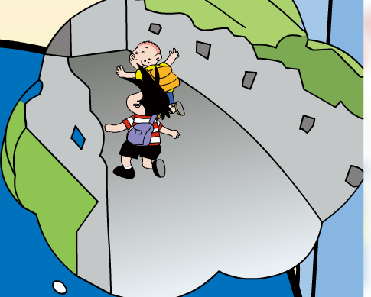
Listen!
Yesterday, they went on a school trip. They went to the
Great Wall. It took them fifty minutes to climb to the
top. They saw lots of mountains and some beautiful
flowers. They ate candies. They bought a present for
Daming’s father.

Slide 6
Read and do!
How many
hours…
Where
What
Feeling
went to the
Great Wall
took fifty
minutes
saw
ate
bought
had a
good time

Slide 7
Retell the text!

Slide 8
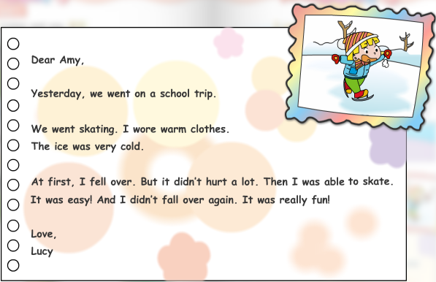
Listen and answer!
Who is the letter from?
What did she do?
What did she wear?
Was she able to skate?
A: Amy B: Lucy
A: She went skating . B: She went skiing.
A: She wore warm clothes. B: She wore a dress.
A: Yes, she was. B: No, she wasn’t.

Slide 9
Read and find!
We went to the Great Wall.
We saw lots of mountains.
We ate candies.
We had a good time.
I wore warm clothes.

Slide 10
动词过去式的变化
动词过去式，ed 来结尾。
一般直接加，见e只加d.
特殊变化特殊记。
过去式的时间状语
Yesterday, last…
didn’t+动词原形

Slide 11
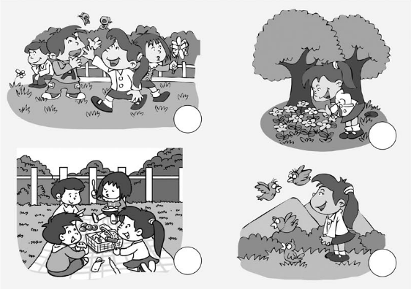
Listen and number!

Slide 12
Time
wore
bought

Slide 13
Time
wore
bought

Slide 14
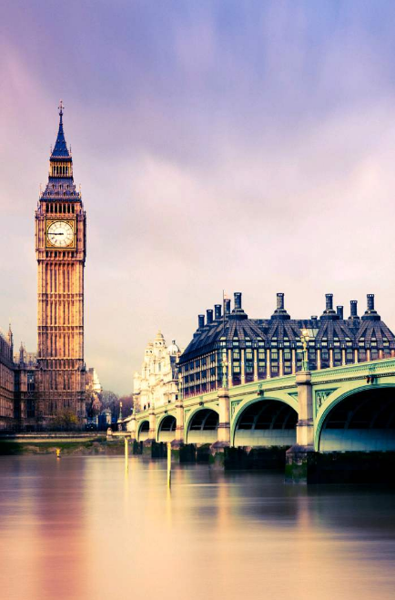
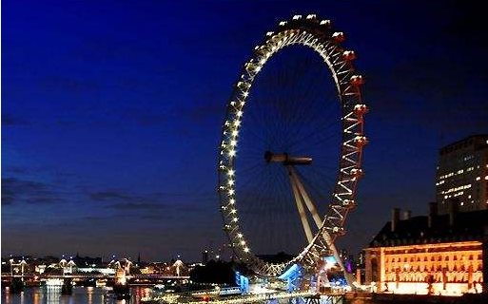
Read and do!
wore were, saw, ate , went , took, had, bought
went
Last year, Sam _______ to London . She went there by plane.
It _________ him3 hours. London is a bit cold now. So he
_______ warm clothes. He __________ the Big Ben and the
London Eye . They _______ very big. He_____________
hamburgers and chips. And he _______ Amy some presents.
He _______ a good time.
took
wore
saw
were
ate
bought
had

Slide 15
Ask and answer!
Where did you go?
I went to…
How many hours did it take?
It took… hours.
What did you do?(eat?/see?...)
I ate/ saw…
How did you feel?
I had a good time!/ I was very happy.

Slide 16
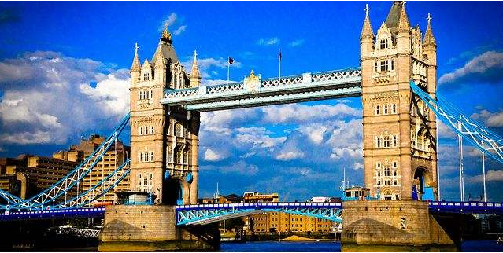
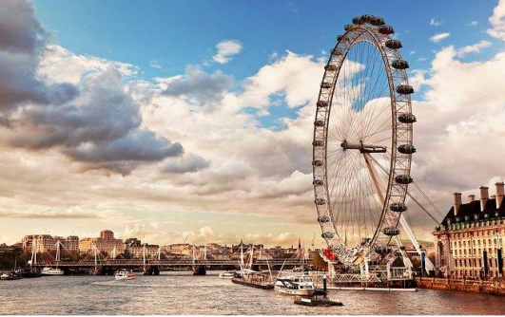
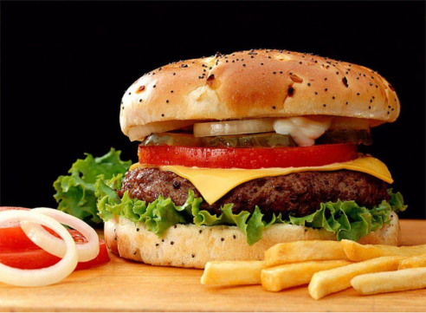
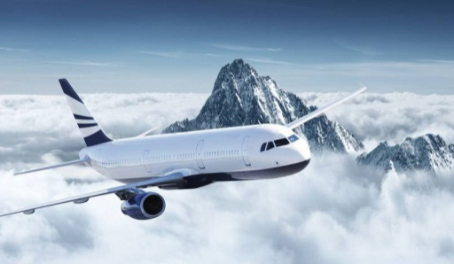
My trip
I went to London last year.
It took me 6 hours.
At first , I saw the Big Ben and the London Eye.
Then I ate hamburgers and chips.
I had a good time!

Slide 17
Be quiet! Be clean !
You are Chinese!

Slide 18
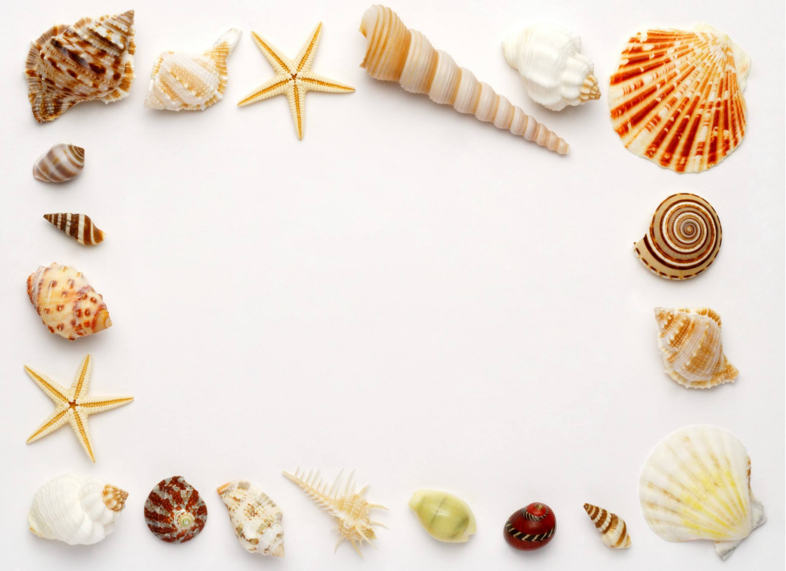
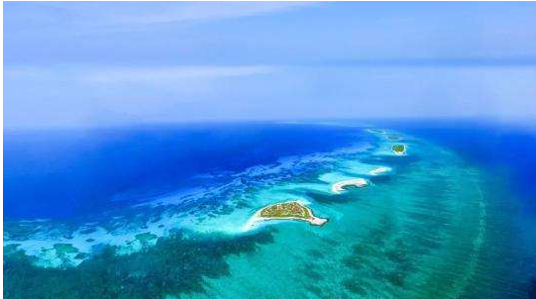
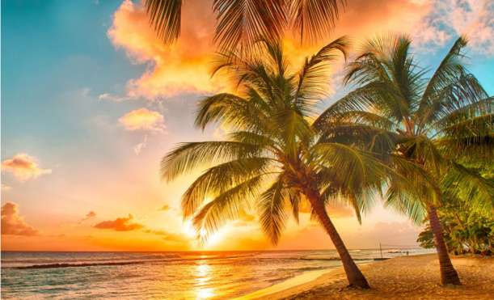
What have we learnt today?

Slide 19
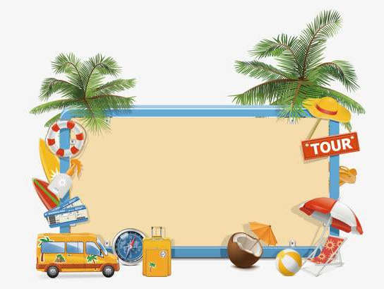
Homework
必做：1. 单词10遍，汉语5遍。
2. 句子5遍。
选做：向朋友介绍你的旅行经历

