Slide 1
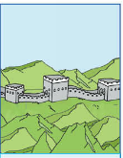
Revision of Module 5
小长山岛镇中心小学
朱宏琴

Slide 3
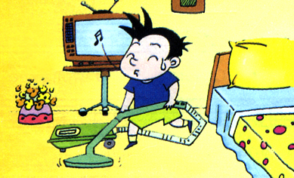
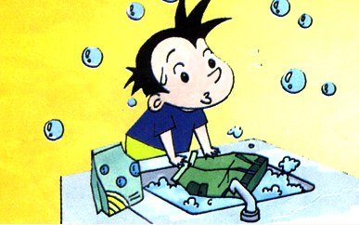
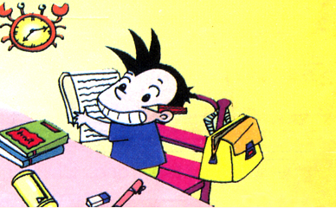
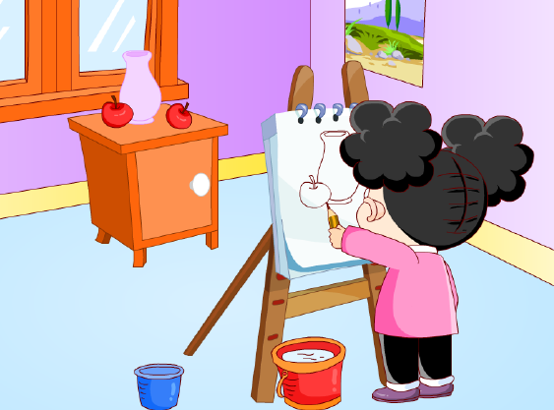
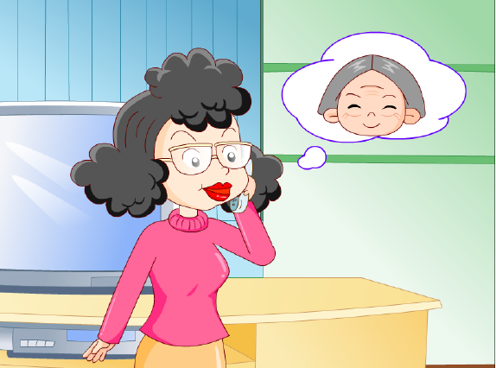
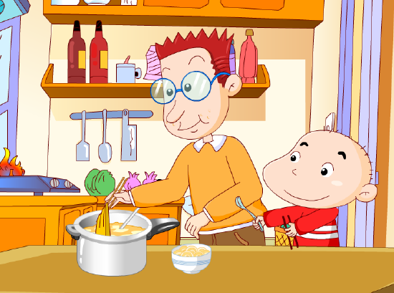
What did they do yesterday?
cleaned
finished
washed
painted
phoned
cooked

Slide 4
Task
运用一般过去时，说明假期活动

Slide 5
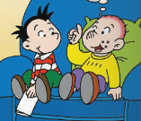
Listen and choose.
Did you go____(to, on )a school trip yesterday?
Yes, we_______ (go, went) to the Great Wall.
It took us _______( fifty, forty) minutes to climb to the top.
And we _____(saw,see) lots of mountains.
We _____ ( ate,eat)candies.And we saw some beautiful ______(plant,plants).

Slide 6
So,you ____(have,had) a good time.
Yes.And we ______(buy,bought) you a present.
It’s a picture _____( of, to) the Great Wall.
Thank you,boys.

Slide 7
Read and judge .
1.Daming and Sam went to the Great Wall. 2.They saw lots of mountains and people.
3.They ate apples.
4.They didn’t buy a present .
5.They had a good time .
T
F
F
F
T

Slide 8
Listen and number .
( )The ice was very cold.
( ) Yesterday, we went on a school trip.
( )At first, I fell over.But I didn’t hurt a lot.
( )we went skating.I wore warm clothes.
( )Then I was able to skate.

Slide 9
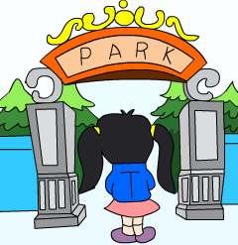
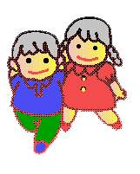
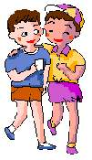
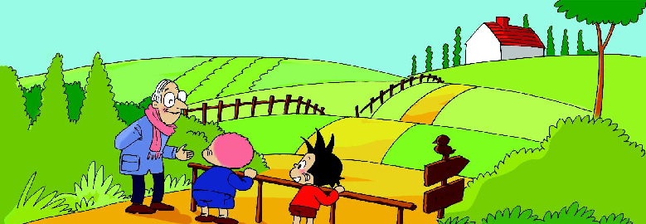
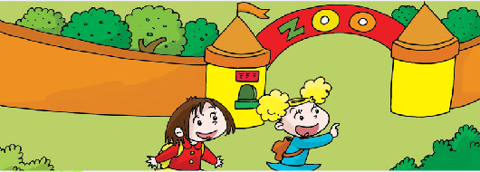
Where did you go? I went to .
Farm

Slide 10
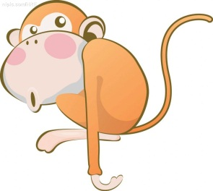
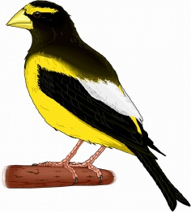
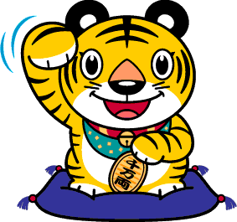
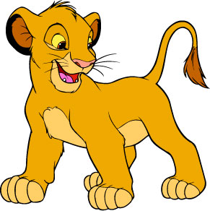
What did you see ? I saw .

Slide 11
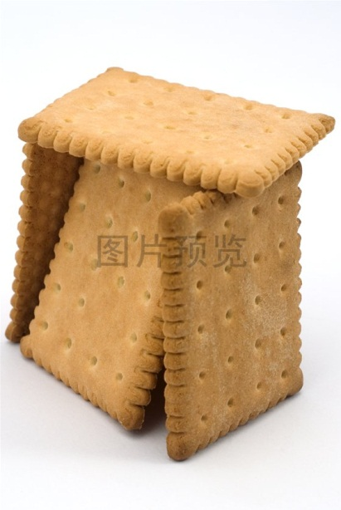
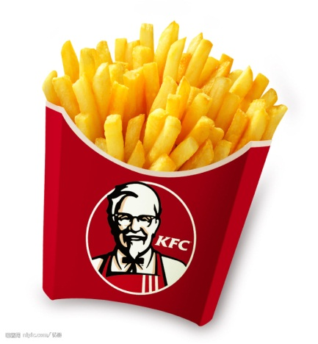
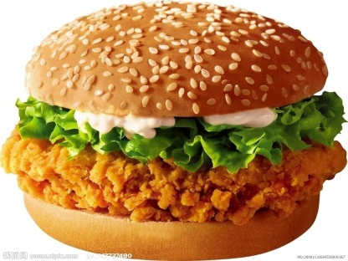
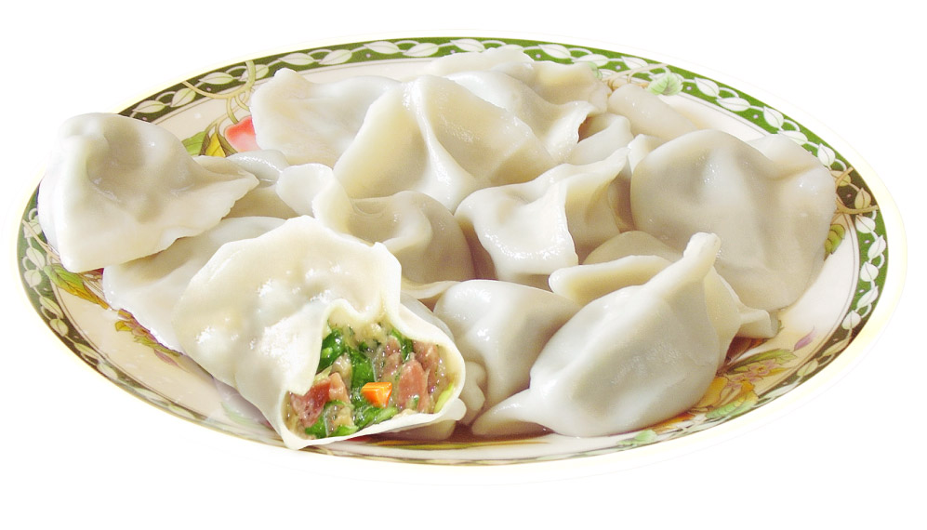
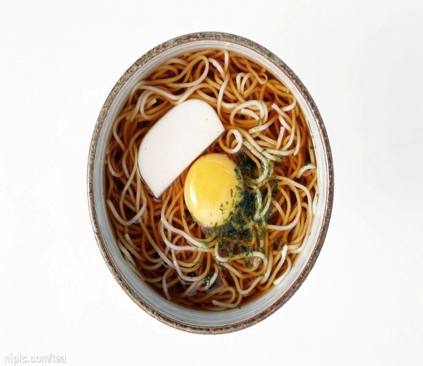
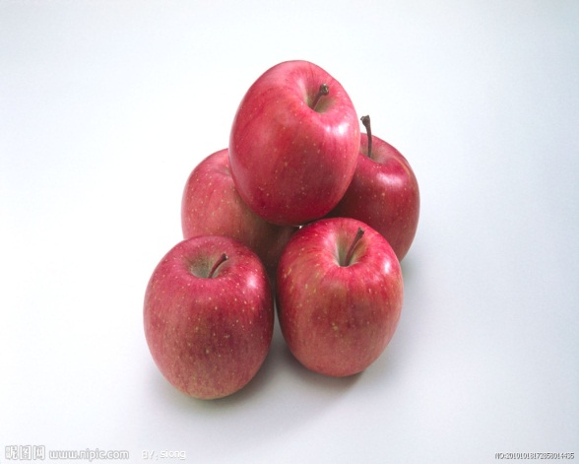
What did you eat?
I ate .

Slide 12
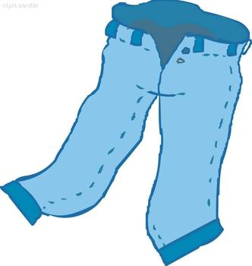
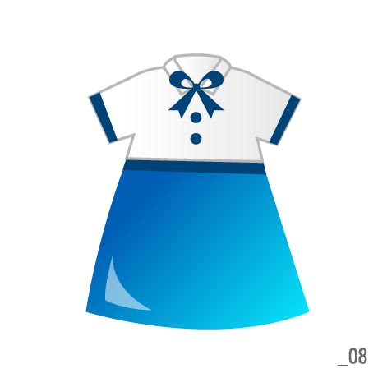
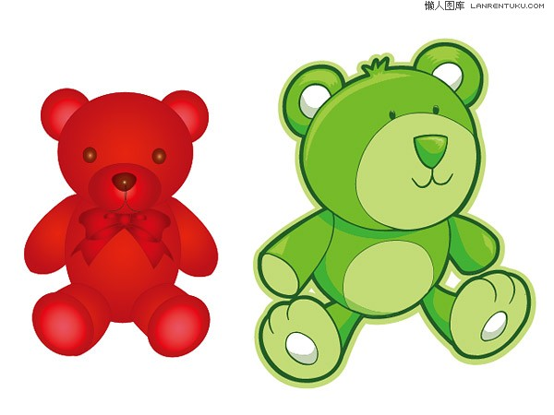
What did you buy?
I bought .

Slide 13
Where did you go? I went to .
What did you see ? I saw .
What did you eat? I ate .
What did you buy? I bought .
……

Slide 14
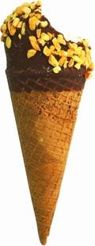
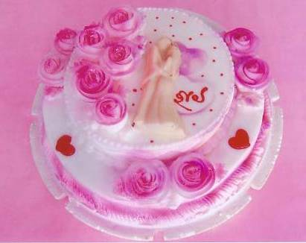
Last year(Last week,Last summer-----),
I went to .
I saw .
I ate .
I some presents.
I a good time.
Farm

Slide 15
Summary
What did you learn this lesson?

Slide 16
Homework
1.Read the text.
2.Finish your composition.

Slide 17
课堂检测
根据提示填单词
1. I _______（去） on a school ________ （旅行）yesterday .
2.I _________ （看见）lots of mountains and some beautiful _________.（植物）
选择
1.I went skating. I ________ warm clothes.
A.wear B.wore C.wearing
2.I ________ mum a present .Mum was very happy.
A. buy B bought C buys

