Slide 1
新标准英语一年级起点第七册
Review Module 6 下
大长山岛镇中心小学
杨春莲

Slide 2
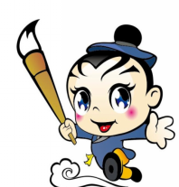
Read and fill.读文，填空。
Long,_____ ____,there was a
good boy,his name ____ Ma Liang.
one night,an old man gave(给) him
a magic paintbrush. Ma Liang
painted a cow,then,the cow ______
(become/became) real.
There was a ____ man,he _____
Ma Liang away. He didn't _____ gold.
He ______ (want/wanted) a gold
mountain. Ma Liang painted it. The
long ago
was
went
bad man _____ to sea in a ship,
but he _____ come back.
didn't
became
bad
wanted
took
have
R

Slide 3
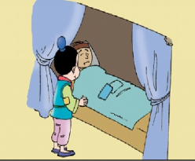
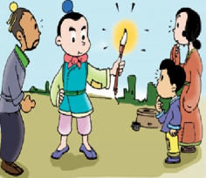
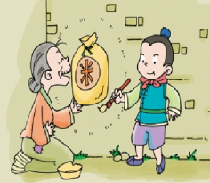
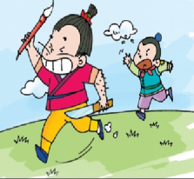
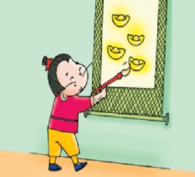
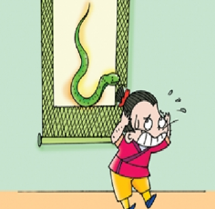
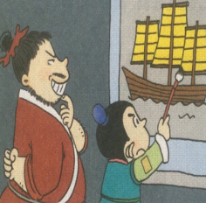
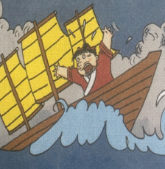
Try to retell the story.复述故事
ago, good boy
helped
had
didn't have
painted
bad man
took
didn't have
painted
didn't become
became
wanted
painted
went , sea
didn't come back

Slide 4
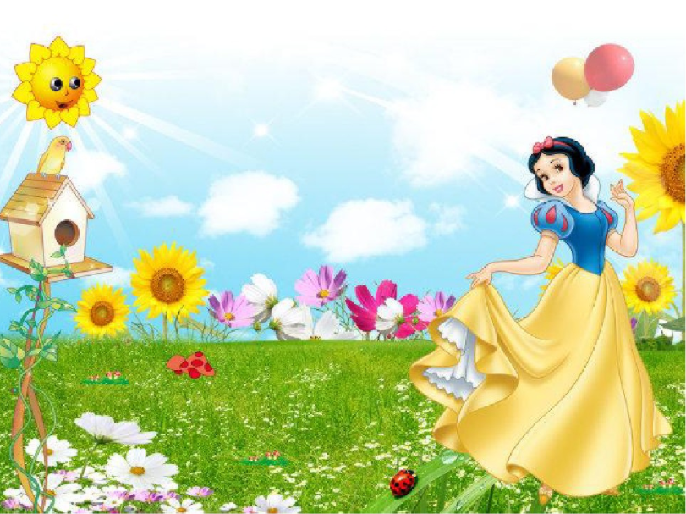
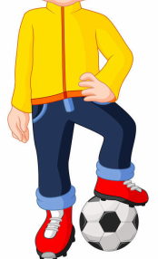
Listen to the story and choose.
听故事，选一选。
Snow White
Snow White was a beautiful princess.

Slide 5
There was a bad queen.She had a magic mirror(镜子).

Slide 6
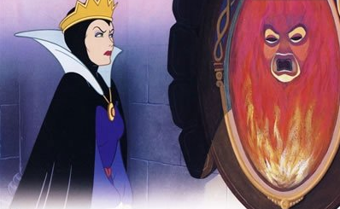
The magic mirror(镜子) said:“Snow White is the most beautiful woman in the world.”The bad queen was angry. She wanted to kill(杀) Snow White.

Slide 7
Snow White went to the forest(森林). There were seven dwarves(矮人).
They like Snow White , so they were good friends.

Slide 8
But the bad queen became an old woman.
She gave an toxic(有毒的) apple to Snow White.

Slide 9
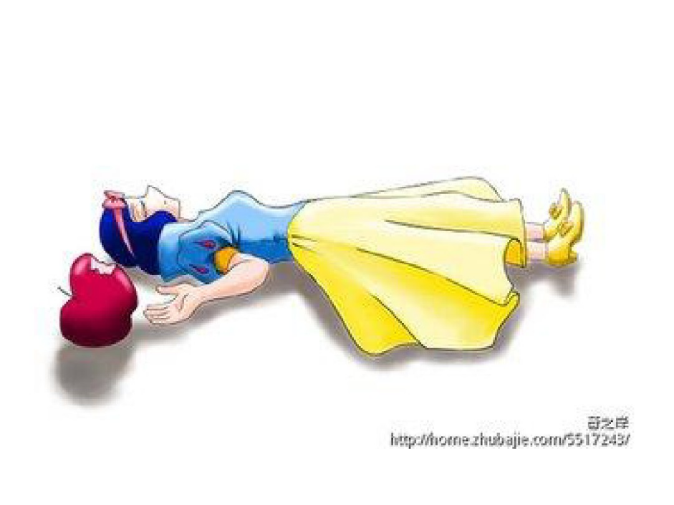
Snow White ate the apple. Then she died(死亡).

Slide 10
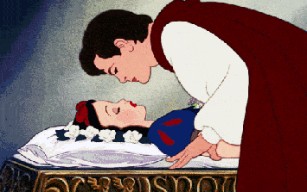
But a prince came and kissed her. Snow became alive(复活) again.

Slide 11
Finally, the prince and Snow White lived a happy life（生活） forever.

Slide 12
Read and choose.读一读，圈一圈。
Snow White was a ______ princess.
A. beautiful B. naughty
2. The bad queen _______ a magic mirror(镜子).
A. didn't have B. had
3.The bad queen became an old ________.
A. woman B. man
4. Snow White ate _______ and died(死亡).
A. a banana B. an apple.
5. Did the prince and Snow White live a happy life?
A. Yes,they did. B. No, they didn't.

Slide 13
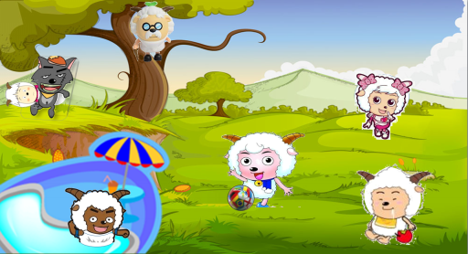

Slide 14
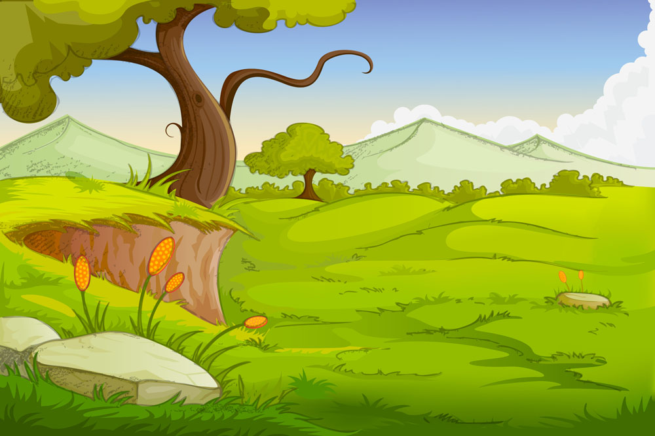
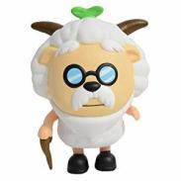
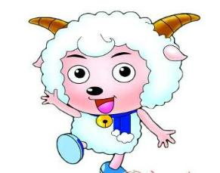
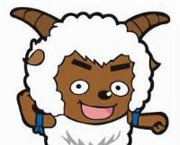
Tell the story. 讲故事
One day, Xi Yangyang and his friends went to a park.
.…
climbed
took…away
wore
didn't
eat
played
went swimming
ate

Slide 15
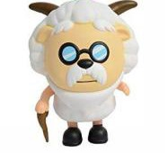
Make your own story and tell .
改编故事并讲一讲。
One day, Xi Yangyang and his friends went to a park.
.…
climbed
took…away
wore
didn't
eat
played
ate
went swimming

Slide 16
Wang Fengli had a very good time on National Day with his friends. Let’s see.

Slide 17
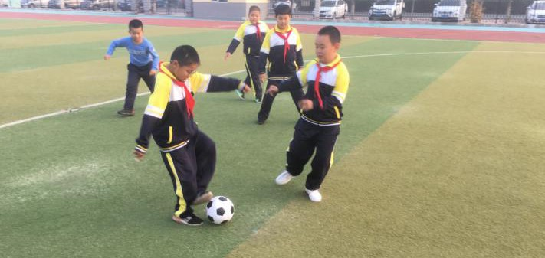
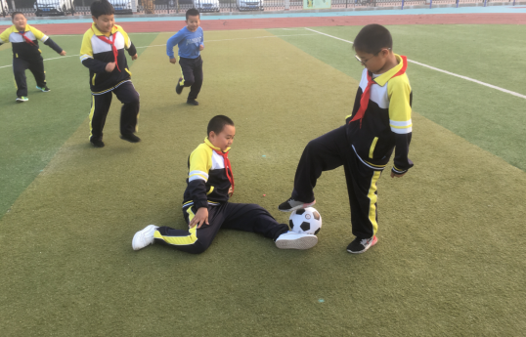
Talk about Fengli’s happy day.
讲讲风力同学的快乐日子。
Wang Fengli’s Happy Day
Where did he go?
He ______ to the park.
What did he do?
He ___ ___ with friends.
What happened(发生)?
He ______ over.
Did he have a good time?
Yes,he ____ a good time.

Slide 18
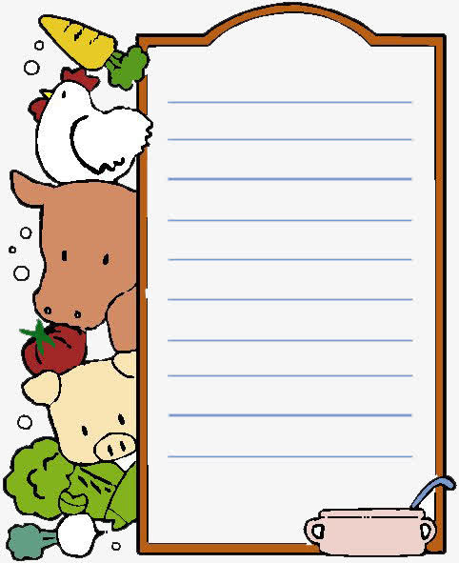
Wang Fengli’s Happy Day
套餐A
套餐B
提示词 went, fell, had, didn’t, played
On National Day, Wang Fengli _____ stay at home. He _____ to the park.He _______ football with his friends.Fengli ______ over, but he _____ hurt a lot.
He _____ a good time.
部分提示词： fall, play
On National Day, Wang Fengli _____ stay at home. He ____ ___the park.He _______ football with his friends.Fengli ______ over, but he _____ hurt a lot.
He _____ a good time.

Slide 19
生活处处有故事，爱生活，大声说出你故事！

Slide 20
Homework:
必做：1.背写M6黑体单词。
2. 完成小习作。
选做：复述今天学到的故事给父母听。

Slide 21
Review Module 4
_ _ _
_ _ _
_ _ _
_ _ _
_ _ _
_ _ _
It didn't become gold.
He didn't come back.
G1 G2 G3

