Slide 1
新标准英语一年级起点第七册
Review Module 6 上
大长山岛镇中心小学
杨春莲

Slide 2
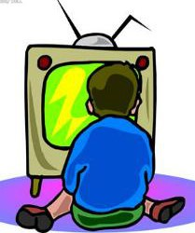
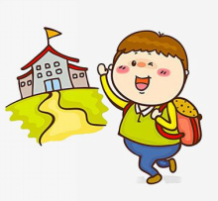
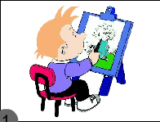
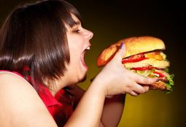
An answer race. 抢答
What did/didn't you do ?
×
go to school
paint a picture
eat a hamburger
watch TV
play football

Slide 3
Task
Review Module 6 and
try to tell stories with the simple past tense .
用一般过去时讲述故事。

Slide 4
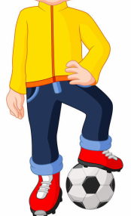
Let's listen.
Dear teacher,
How are you ? I had a good time on National Day. I didn't stay at home, I played football with my friends.
And I went to the bookshop. At the bookshop, I watched a CD named Ma Liang. And I bought a Snow White book. I like it. And I painted a picture there.
I will show them to you. Happy National Day!
From,
Wang Fengli

Slide 5
Let's have a match.连线
Where did he go? He painted a picture.
What did he buy? He didn't stay at home.
What did he paint? A CD named Ma Liang.
What didn't he do? He went to a bookshop.
What did he watch? He bought a Snow White book.

Slide 6
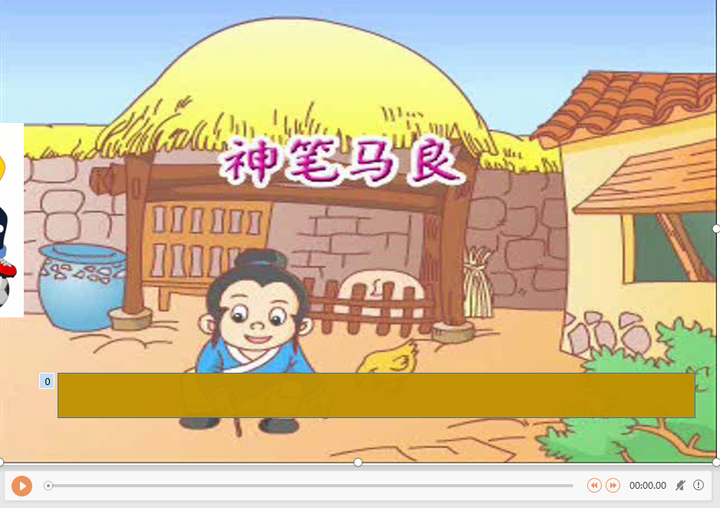
Let's have a match.连线

