Slide 1

Review Module 5
Asking for permission
offering help

Slide 2
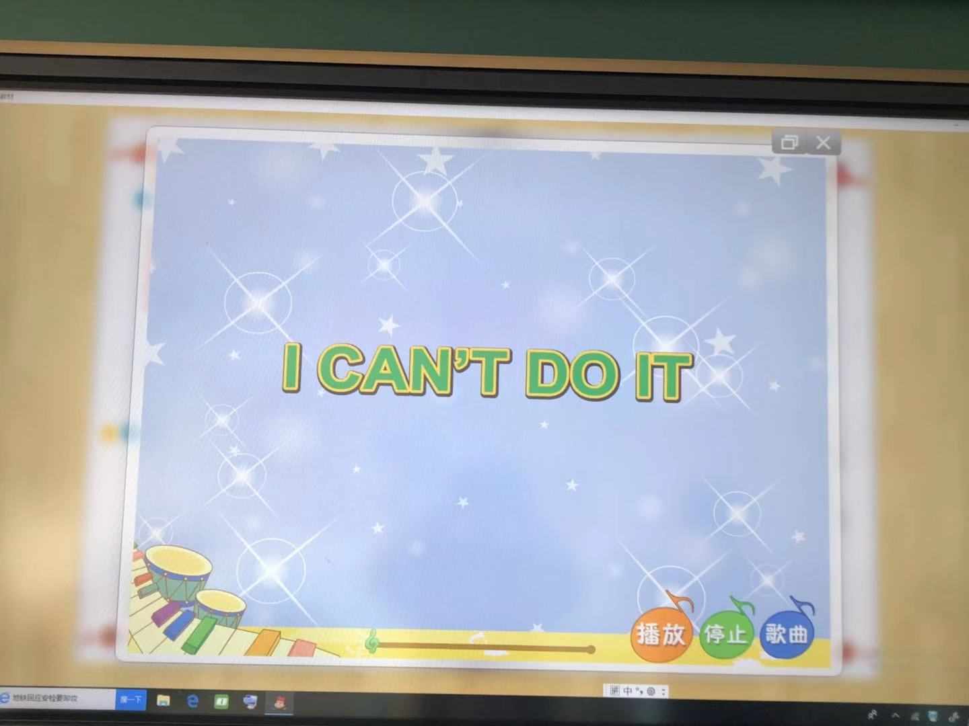
Let's sing.

Slide 3
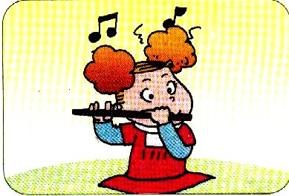
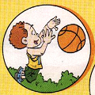
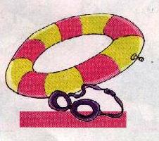
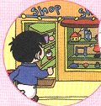


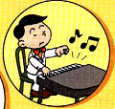
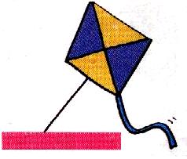
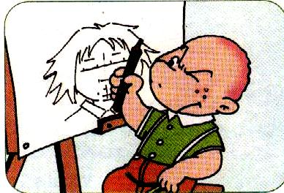
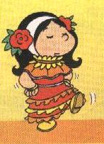
Freetalk
I can... I can't...
...

Slide 4
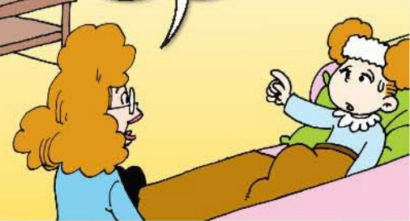
Task
用Can I ...?请求获得允许，能用Yes，you can/No,you can‘t.来回答。讨论规则。

Slide 5
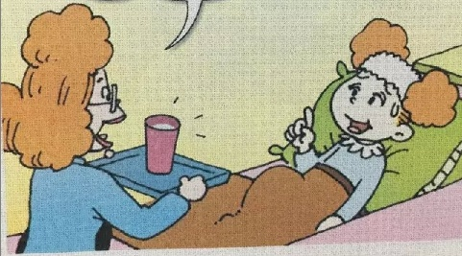
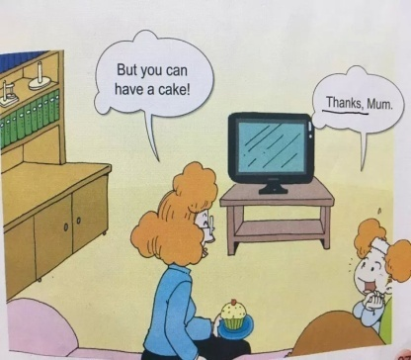
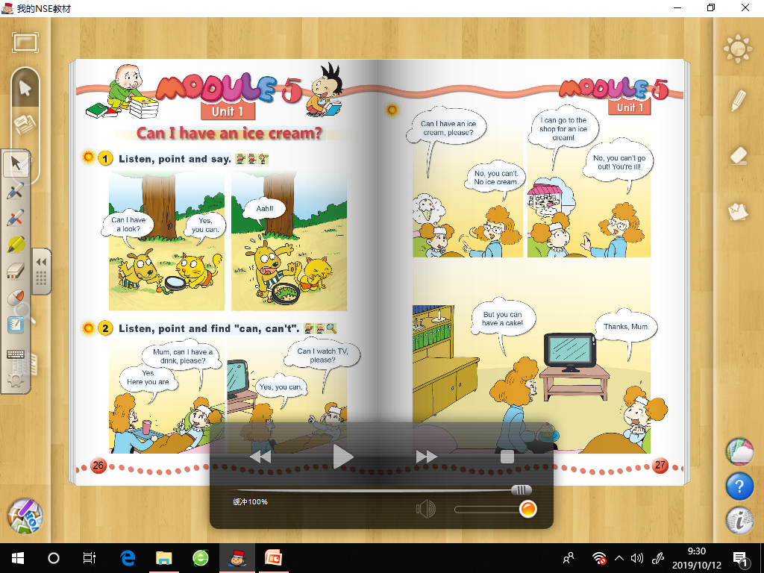
Read and think.
What are Amy’s requests(请求)?
1. Can I have a drink,please?
Yes.Here you are./Yes,you can.
2.Can I watch TV,please?
Yes, you can.
3.Can I have an ice cream?
No, you can’t.

Slide 6
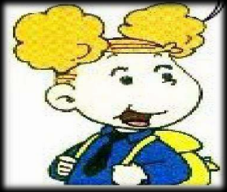
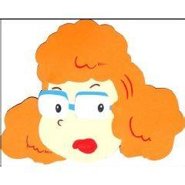
Think and ask.
Can I go to the shop for an ice cream?
Why?
No, you can't.
You can't go out.

Slide 7
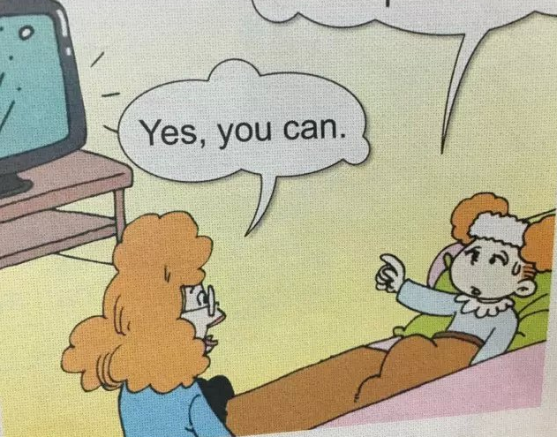
Mum, can I___ ___ ___, please?
Yes. __ __ __.
__ I ____ ___, please?
Yes, __ __.
Can I__ __ _____, please?
___, you can’t.

Slide 8

Do you know?
请求别人允许自己做某事，可以礼貌地说：
Can I …, please?
Yes, you can.
No, you can’t.

Slide 9
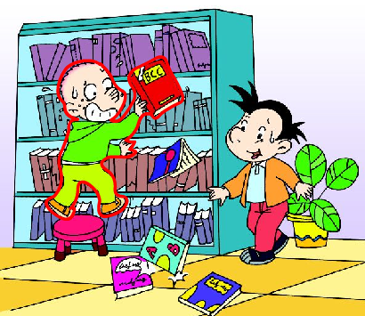
Read and think
Can Sam read the book?
Yes, he can.
What does Daming say?
Don’t worry . You can read all the books now.

Slide 10
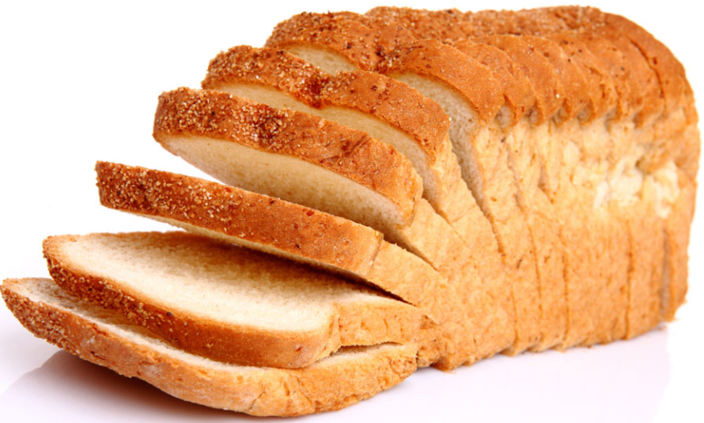
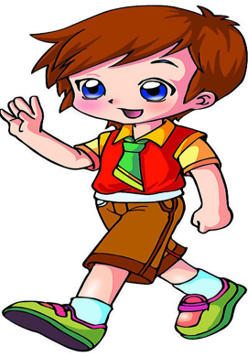
Yes, he can
No.he can't
Can he …?

Slide 11
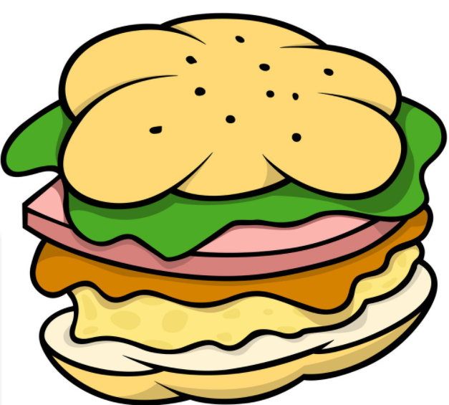
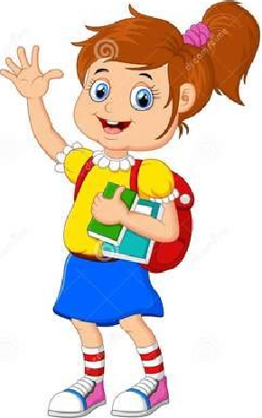
Can she …?

Slide 12

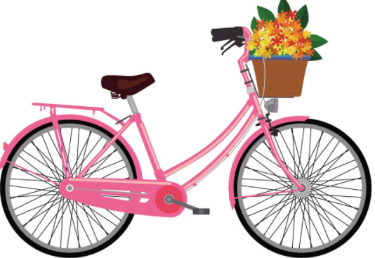

Listen and draw
（（（（
（ ）
（ ）
（ ）
（ ）
（ ）

Slide 13
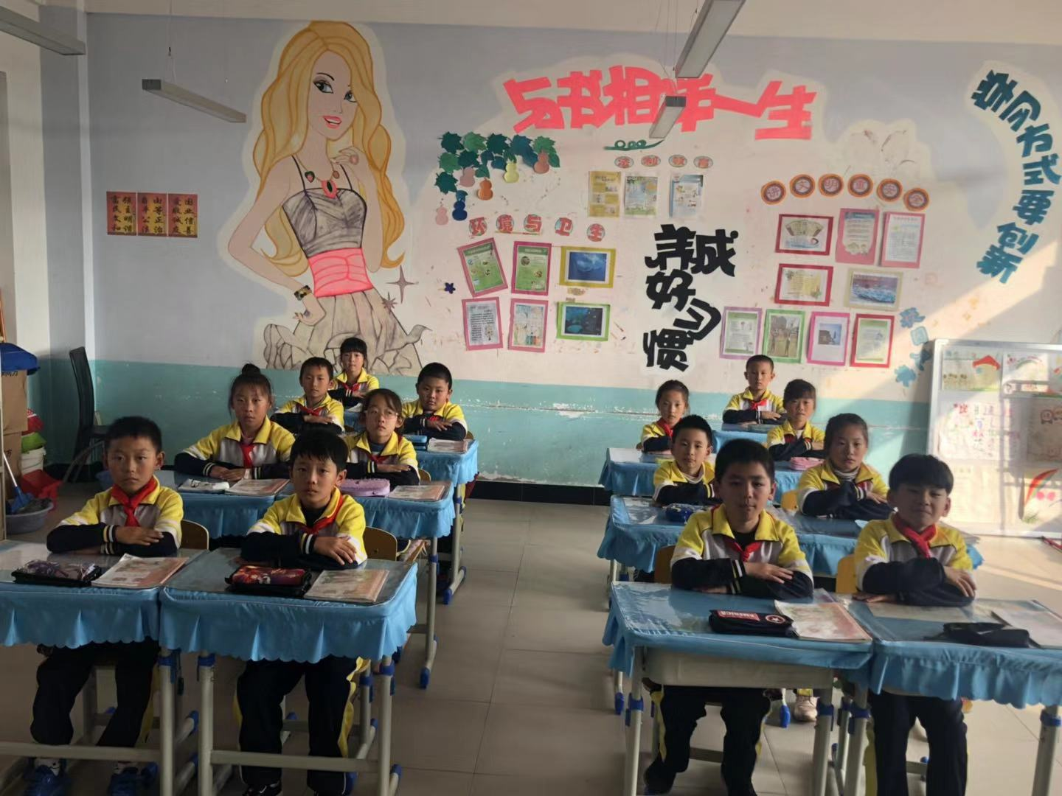
Show time.
In the classroom
do homework
read books
sing songs
play football
have a drink
fly a kite
ride a bike
...
Can I …?
Yes, you can./No, you can’t.

Slide 14
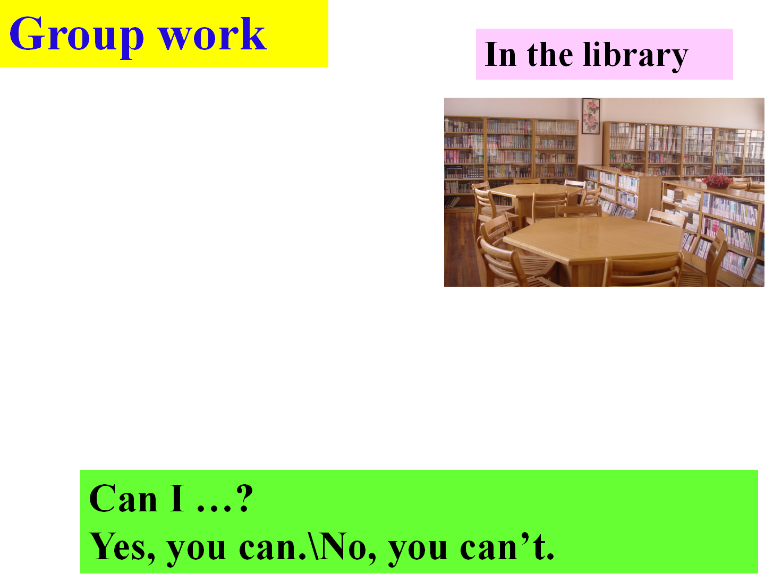
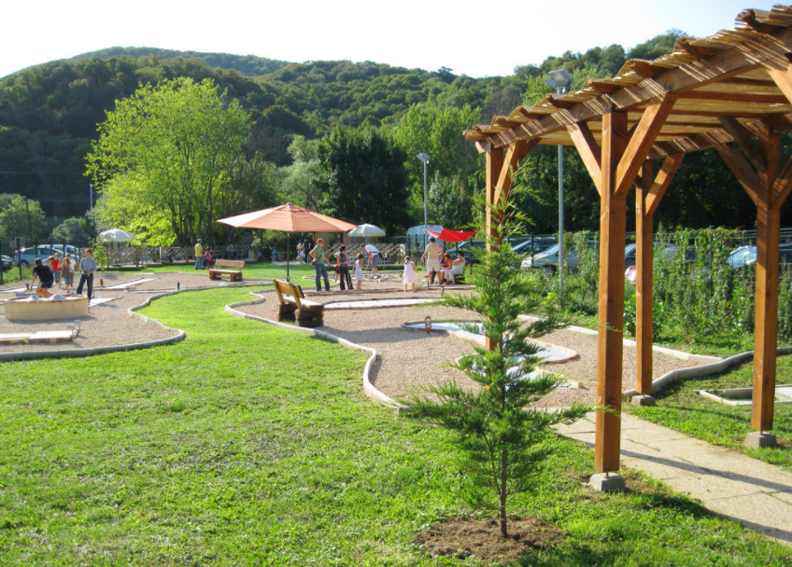
Show time.
In the library
In the classroom
Can I …?
Yes, you can.
No, you can’t.
In the park

Slide 15
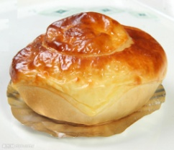






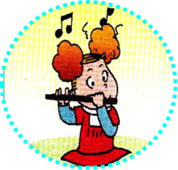

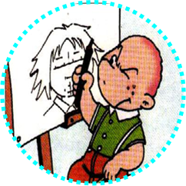
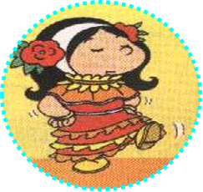


V
V
V
bread
ice cream
drink
chips
V
V
V
football
basketball
flute
piano
V
V
draw
sing
fly
swim

Slide 16
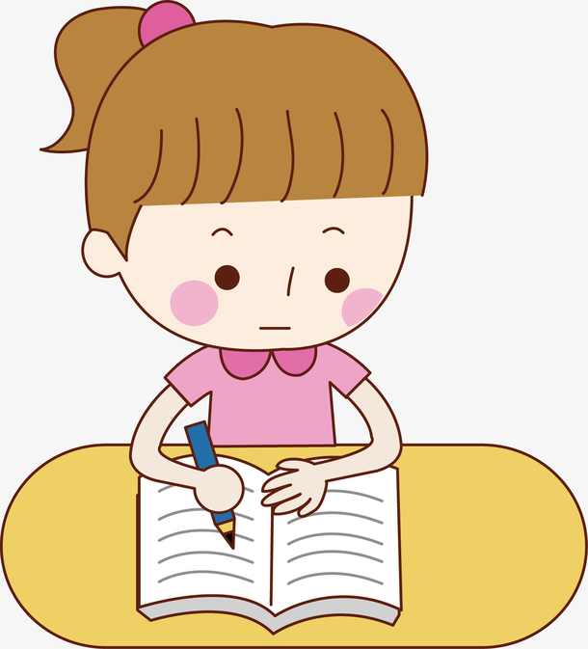
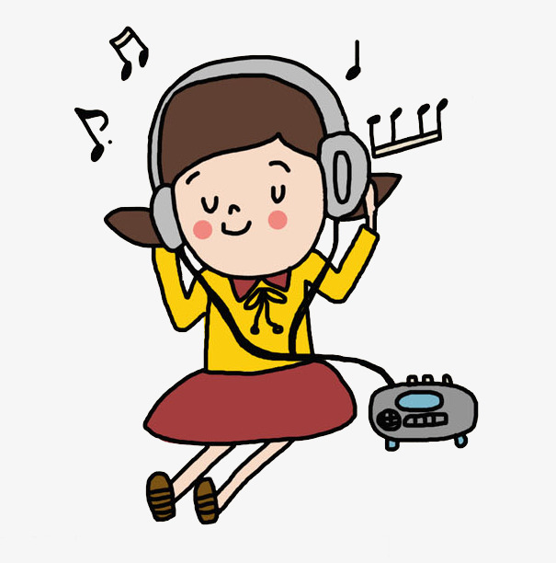
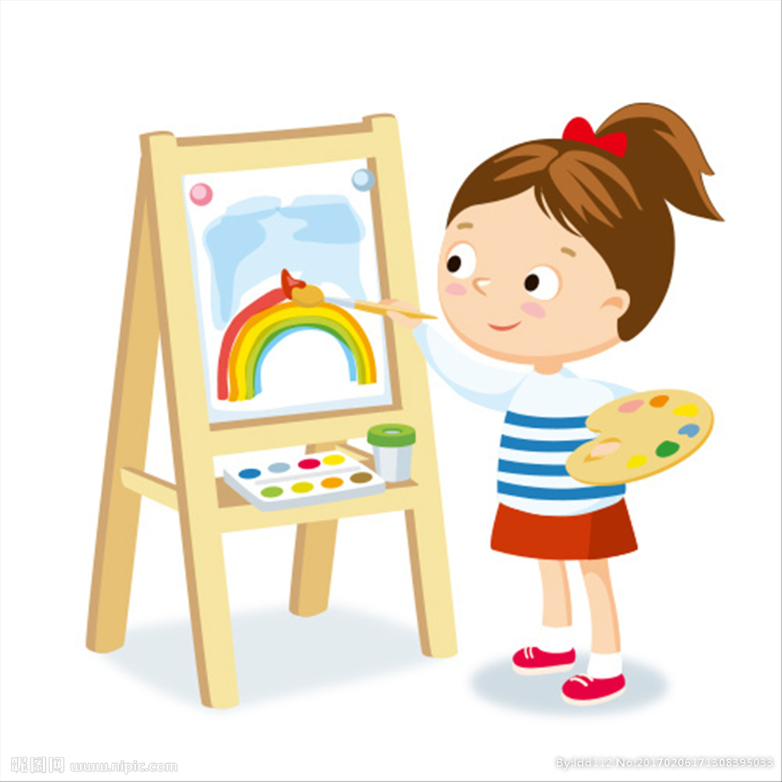
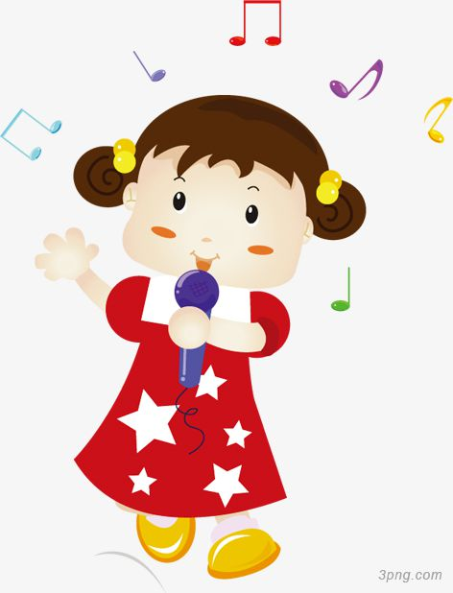
Read and judge
Grandma and grandpa are sleeping.I can't watch TV.I can do my homework.I can draw a picture.I can't sing a song and I can't listen to the radio.
1.Can I ? A. Yes, you can. B.No, you can't.
2.Can I ? A. Yes, you can. B.No, you can't.
3.Can I ? A. Yes, you can. B.No, you can't.
4.Can I ? _______________.
5.Can I ? ___________________ .

Slide 17

Follow the rules 遵守规则
Learn to ask 学会询问
Be civilized 做文明人

Slide 18


选择一项作业：
A. Try your best to retell the text.
尽力复述课文。
B. Choose other places and make
a dialogue with your friend.
另外选择几个场景与你的朋友做对话。

Slide 19
Show time.
In the classroom
do homework
read books
sing songs
play football
have a drink
fly a kite
ride a bike
...
Can I …?
Yes, you can./No, you can’t.

Slide 20
Show time.
In the library
do homework
read books
sing songs
play football
have a drink
fly a kite
ride a bike
...
Can I …?
Yes, you can./No, you can’t.

Slide 21
Show time.
In the park
do homework
read books
sing songs
play football
have a drink
fly a kite
ride a bike
...
Can I …?
Yes, you can./No, you can’t.

